Slide 1
Good Afternoon
Alison Ashley Esai Jacob | Jaret Tyler Paola | Alexa Anthony Dyonna Reid | Brooke Connor Danny Michael
Haylee Kevon Pedro Tiffani | Emma Kenny Madi M Ryan | Caleb Joseph Madi W | Chad Destineh Jack Olivia
Please sit with your new groups and take out a few pieces of binder paper and your vocabulary chart.

Slide 2
Discuss at your table
What are some of the characteristics of a Revolution?
Speculate on what an Industrial Revolution might be.
What do you know about Industry?
What do you know about Railroads?
Have any members of your family worked in a factory?

Slide 3
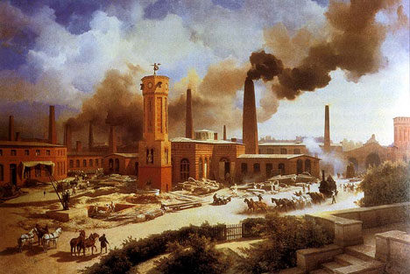
Why study the Industrial Revolution?

Slide 4
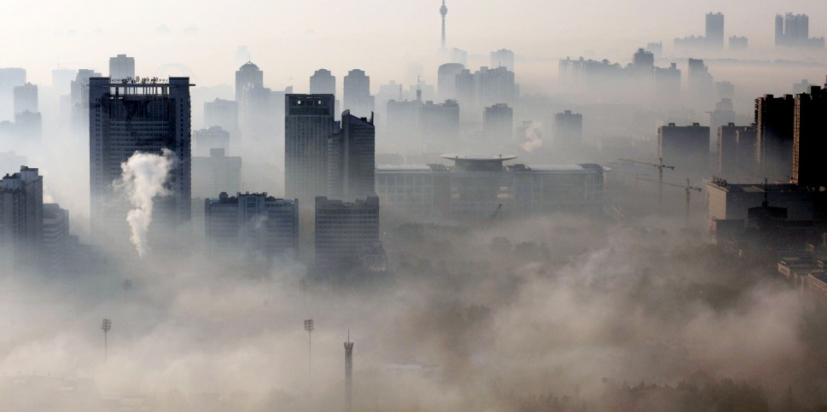
All nations face problems of industrialization, such as air and water pollution, acid rain and crowded cities.

Slide 5
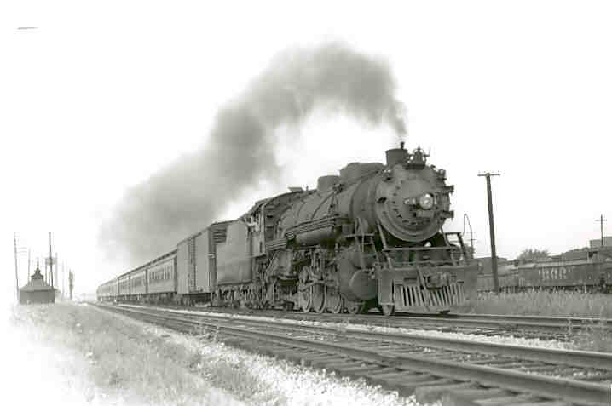
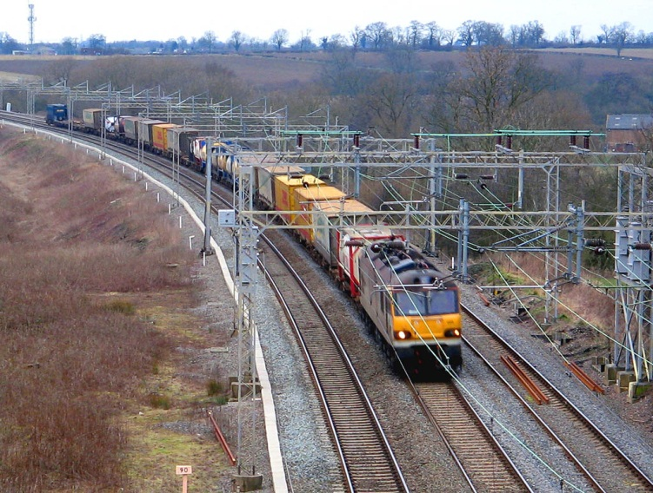
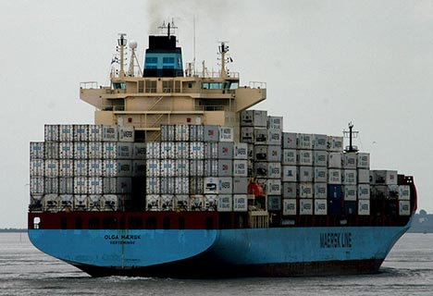
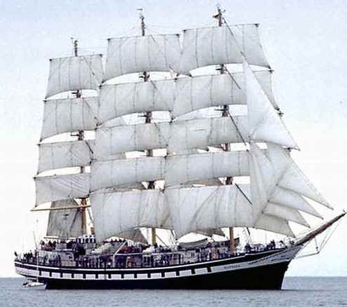
Today’s global society depends on transportation and communication that can be traced back to the Industrial Revolution.

Slide 6
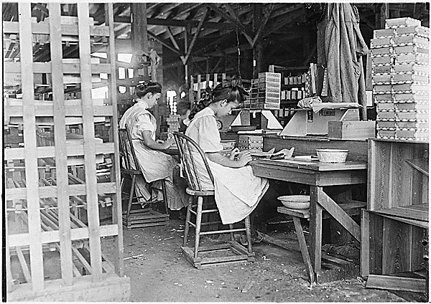
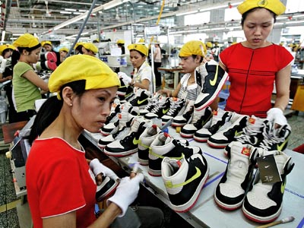
Industrialized nations such as the US and those in western Europe continue to use low-wage labor from less-industrialized nations.

Slide 7
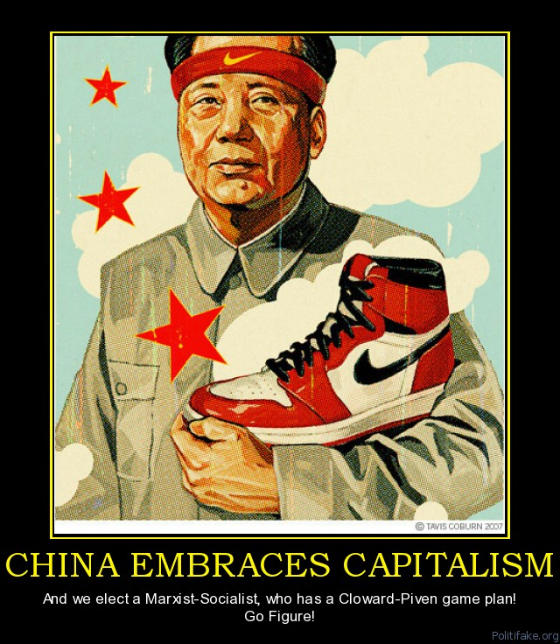
Socialism and Communism have increasingly given way to capitalism, causing major global upheavals in places such as Russia and eastern Europe.

Slide 8
Tensions continue between the industrialized nations of Europe and North America and less developed nations such as those in Africa and South America.

Slide 9
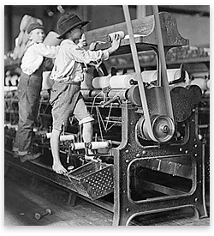
What are fair working conditions?
What do you see in this image?
Would you attempt to change your working conditions in the factory?
Would you join a union, go to school or run away?

Slide 10
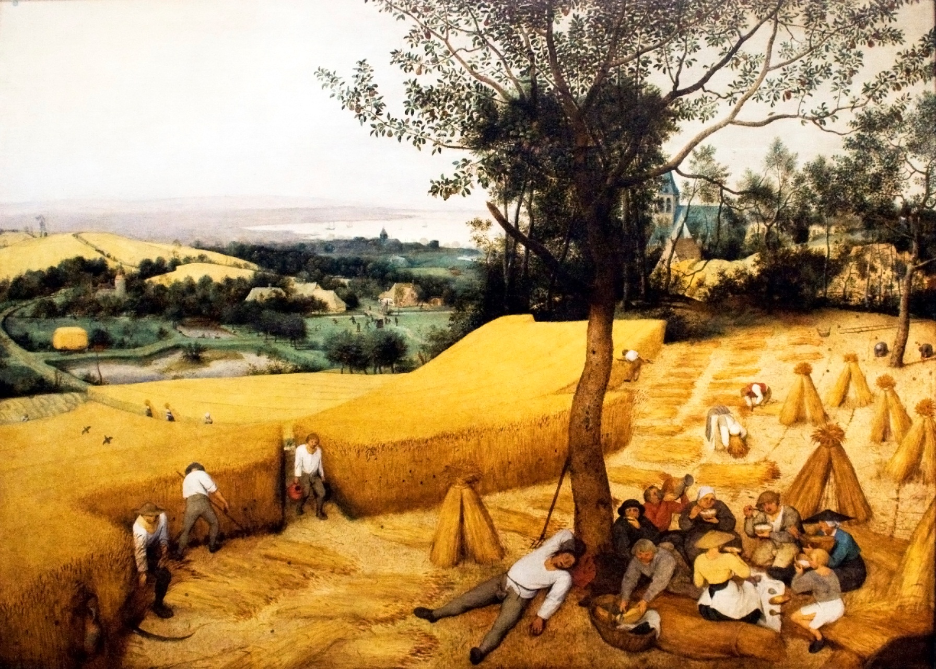
The Beginnings of Industrialization

Slide 11
Industrial Revolution Begins in Britain
New Ways of Working
Industrial Revolution- greatly increases output of machine-made goods
Revolution begins in England in the middle 1700’s

Slide 12
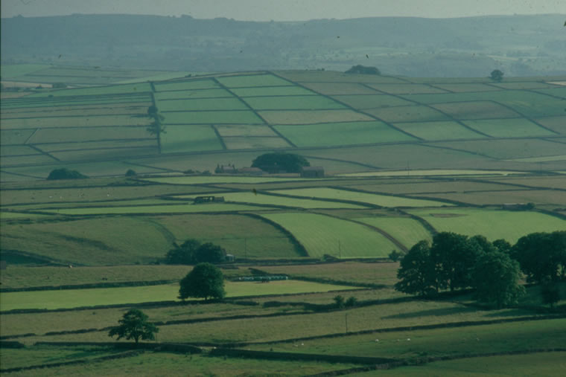
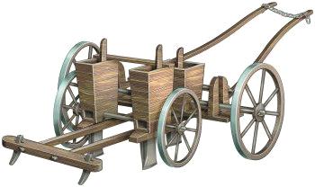
The Agricultural Revolution Paves the Way
Enclosures- large fields enclosed by fences
Wealthy landowners buy, enclose land once owned by village farmers.
Enclosures allow experimentation with new agricultural methods.
Jethro Tull’s Seed Drill

Slide 13
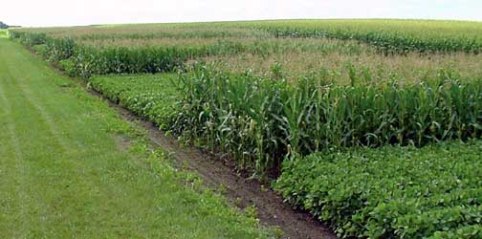
Rotating Crops
Crop rotation- switching crops each year to avoid depleting the soil
Livestock breeders allow only the best to breed, improves the food supply

Slide 14
Why does the Industrialization Revolution Began in England?
Britain has natural resources- coal, iron, rivers, harbors
Expanding economy in Britain encourages investment.
Highly developed banking system to loan money and invest in new industries.
Politically stable, Parliament passes laws that help businesses
Has all needed factors of production- land, labor, capital

Slide 15
Inventions Spur Industrialization
Changes in the Textile Industry
Weavers work faster with flying shuttle and spinning jennies.
Water frame uses water power to drive spinning wheels
Power loom, spinning mule speed up production, improve quality
Factories- buildings the contain machinery for manufacturing
Cotton gin boosts American cotton production to meet British demand.

Slide 17
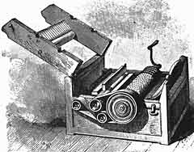
In 1793 American Eli Whitney invents the cotton gin and cotton production skyrocketed.

Slide 18
Improvements in Transportation
Watt’s Steam Engine
Need for cheap, convenient power spurs development of steam engine
James Watt improves steam engine, financed by Matthew Boulton
Boulton was an entrepreneur- organizes, manages, takes business risks

Slide 19
Good Afternoon
Please take out the following:
Notes from yesterday
Writing Prompt 1
Unit Calendar
Something to write with

Slide 20
Match the definition to the term
Resources needed to produce goods and services; land, labor, and capital
The process of developing machine production of goods.
Fencing off of land
Planting different vegetables and grains to restore nutrients.
A person who organizes, manages, and takes on the risks of a business.
Crop rotation
Enclosures
Entrepreneur
Factors of production
Industrialization

Slide 21
6. Which is not a reason that the Industrial Revolution began in Britain?
Water power and coal to fuel new machines.
A small population of workers
Iron ore to construct new machines
Harbors from which its merchant ships set sail

Slide 22
7. What system in Britain contributed to the country’s industrialization?
Transportation system
Sound system
Market system
Banking system

Slide 23
8. The first industry to transform is the ______________.
Coal industry
Iron industry
Textile industry
Transportation industry

Slide 24
9. Which of the following is not an early invention?
Flying shuttle
Spinning Jenny
Water Frame
Power mule

Slide 25
10. This American invented the Cotton Gin?
Samuel Slater
James Watt
Edmund Cartwright
Eli Whitney

Slide 26
11. The introduction of this invention made travel easier?
Steam Engine
Power Mule
Flying Shuttle
Heavy Wagon

Slide 27
12. This inventor’s steamboat, the Clermont, ferried passengers along the Hudson River?
James Watt
Robert Fulton
Matthew Boulton
Eli Whitney

Slide 28
13. Which of the following is an American invention?
McCormick’s Reaper
Morse’s Telegraph
Singer’s Sewing Machine
All are American inventions

Slide 29
Match the definition to the term
Resources needed to produce goods and services; land, labor, and capital
The process of developing machine production of goods.
Fencing off of land
Planting different vegetables and grains to restore nutrients.
A person who organizes, manages, and takes on the risks of a business.
Crop rotation
Enclosures
Entrepreneur
Factors of production
Industrialization

Slide 30
6. Which is not a reason that the Industrial Revolution began in Britain?
Water power and coal to fuel new machines.
A small population of workers
Iron ore to construct new machines
Harbors from which its merchant ships set sail

Slide 31
7. What system in Britain contributed to the country’s industrialization?
Transportation system
Sound system
Market system
Banking system

Slide 32
8. The first industry to transform is the ______________.
Coal industry
Iron industry
Textile industry
Transportation industry

Slide 33
9. Which of the following is not an early invention?
Flying shuttle
Spinning Jenny
Water Frame
Power mule

Slide 34
10. This American invented the Cotton Gin?
Samuel Slater
James Watt
Edmund Cartwright
Eli Whitney

Slide 35
11. The introduction of this invention made travel easier?
Steam Engine
Power Mule
Flying Shuttle
Heavy Wagon

Slide 36
12. This inventor’s steamboat, the Clermont, ferried passengers along the Hudson River?
James Watt
Robert Fulton
Matthew Boulton
Eli Whitney

Slide 37
13. Which of the following is an American invention?
McCormick’s Reaper
Morse’s Telegraph
Singer’s Sewing Machine
All are American inventions

Slide 38
The Railway Age Begins
Steam-Driven Locomotives
In 1804, Richard Trevithick builds first steam-driven locomotive
In 1825, George Stephenson builds worlds first railroad line.

Slide 39
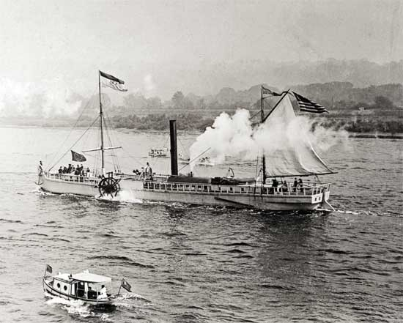
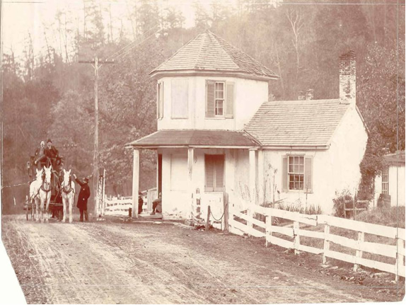
Water Transportation
Robert Fulton builds first steamboat, the Clermont, in 1807
England’s water transport improved by system of canals.
Road Transportation
British roads are improved; companies operate them as toll roads.

Slide 40
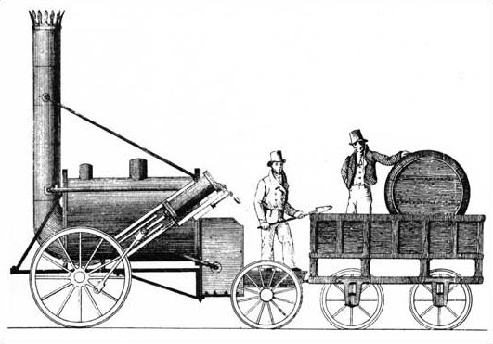
The Liverpool-Manchester Railroad
Entrepreneurs build railroad from Liverpool to Manchester.
Stephenson’s Rocket acknowledged as the best/fastest locomotive in 1829 going more than 24 mph.

Slide 41
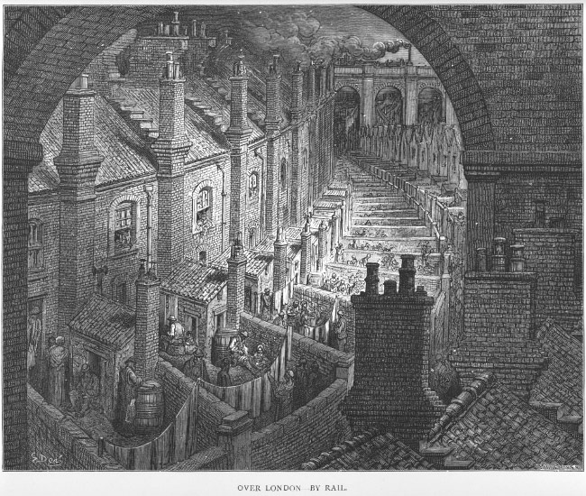
Railroads Revolutionize Life in Britain
Railroads spur industrial growth, create jobs
Cheaper transportation boosts many industries; people move to cities.

Slide 42
Writing Prompt 1
Was the revolution in agriculture necessary to the Industrial Revolution? Explain using evidence from the textbook

Slide 45
Developing Strong CLAIM statements
Use pages 12-13 of the toolkit.
Cross off all of “thesis” and change them to claim.
There will be 28 changes.
Highlight the 4 ways you can tell a strong claim statement from a weak one.
Take a look at your claim statement from WP1.
Is it strong or weak?
How could you make it even stronger?

