Slide 1
Agenda
Short video: Recap
Review: Fall of Napoléon
Lecture: Congress of Vienna
Take Cornell Notes
Summary
1 Paragraph

Slide 2
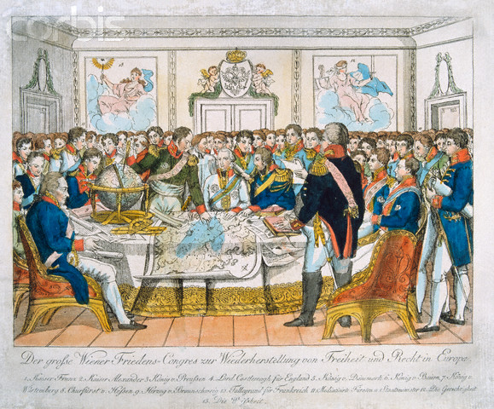
Congress of Vienna
Mr. Saeteurn

Slide 3
Outline
Video: Recap
Review: Fall of Napoléon
Learning Targets
Background
Plan for Europe
Policies changes after Vienna
Key Terms:
Congress of Vienna, Concert of Europe, Balance of Power

Slide 4
Video Recap
http://www.youtube.com/watch?v=IF4lPWU_qxY&safe=active

Slide 5
Fall of Napoléon
Which Country did Napoléon Blockade?
Great Britain
Why did the blockade fail?
Not tight enough
What policy did Russia adopt against Napoléon?
Scorch earth policy
Who took over after Napoléon first defeated?
King Louis XVIII
What was the final battle for Napoléon?
Battle of Waterloo
Where was Napoléon exiled too?
St. Helena, remote island in South Atlantic
Died 6 years later in 1821

Slide 6
Learning Targets
3.4. After Napoleon, European leaders at the Congress of Vienna tried to restore order, reestablish peace, and repress nationalism. | Klemens von Metternich Congress of Vienna Concert of Europe | Balance of Power | Legitimacy
10.2.5
Discuss how nationalism spread across Europe with Napoleon but was repressed for a generation under the Congress of Vienna and Concert of Europe until the Revolutions of 1848.
10.9.8
Discuss the establishment and work of the United Nations and the purposes and functions of the Warsaw Pact, SEATO, NATO, and the Organization of American States.

Slide 7
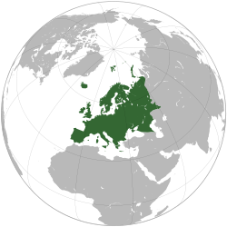
Background
Napoléon is defeated
Goal: Set up new European order
One that allowed for collective security and stability of Europe

Slide 8
Plan for Europe
Representatives from 5 “great powers”
Russia, Austria, Great Britain, France
Klemens Von Metternich
Foreign minister of Austria
3 goals
Prevent future French aggressions by surrounding the France with strong countries
Balance of Power: No country would be a threat to one another
Restore royal family

Slide 9
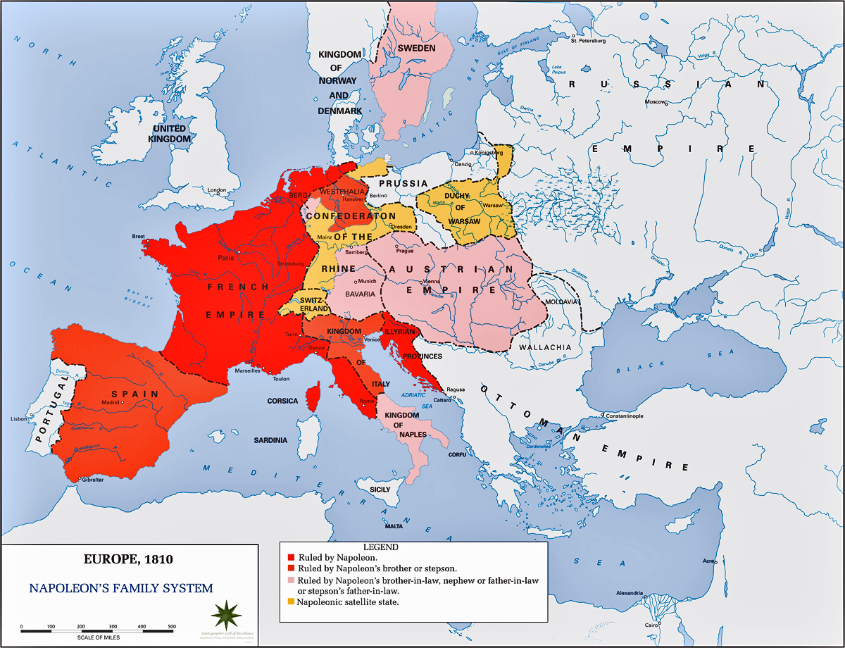

Slide 10
Plan For Europe
Containment of France
Make neighbors of France stronger
39 German states combined to create Austria
Switzerland= independent nation
Kingdom of Sardinia, Italy was strengthened by adding Genoa

Slide 11
Plan For Europe
Balance of Power
Did not want to weaken France entirely
Feared revenge
Did not break up France
Feared another country might get to powerful
France remained major power
No country in Europe= too strong

Slide 12
Plan For Europe
Legitimacy
Restored rulers in Europe Napoléon defeated
France, Spain, Italy, Central Europe
Believed it would stabilize political relations
Overall
Political Triumph
Nations of entire continent cooperated
Settlements were fair
Not one country was left bearing a grudge
Created Peace between great powers for 40 years
Countries would come to aid of one another in case of threats to the peace

Slide 13
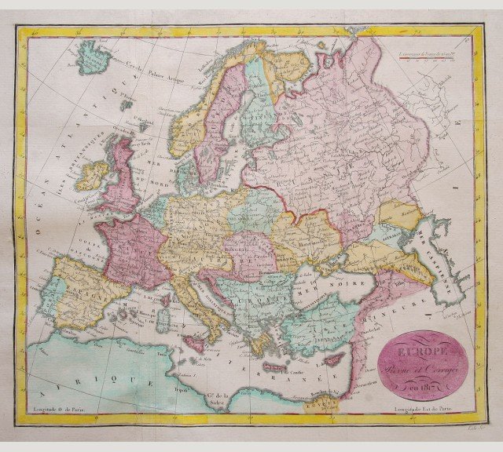

Slide 14
Questions
How would making France’s neighbors stronger contain France?
Why did they want a balance of power in Europe?
Which nations did Congress of Vienna restore the monarchy too?

Slide 15
Political changes after
Britain and France are now Constitutional Monarchies
However in eastern and central Europe many were absolute monarchies

Slide 16
Political changes after
Conservative Europe
Rulers were nervous
“Liberty, equality, and fraternity” might encourage revolution elsewhere
“Holy Alliance”
Czar Alexander I, Emperor Francis I of Austria, King Frederick William III of Prussia signed agreement
Based relations with other nations on Christian principles
Combat revolution
Concert of Nations
Agreement to help each other out if revolution broke out
However could not turn back the clock
Ideas of liberty, equality, and fraternity remained
Revolutions broke out between 1830 and 1848

Slide 17
Political changes after
Revolution in Latin America
Defeat of Spain in Peninsular War meant liberal Creoles (Colonist born in Spanish America) seized control of colonies
Congress restored Spanish throne
Attempted to regain control over colonies
Creoles however expanded their powers
Spanish king tries to tighten control
Angered colonies
Mexico revolt, over throw Spanish control
Other Latin American colonies followed

Slide 18
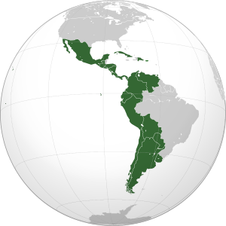

Slide 19
Political changes after
Long-term legacy
France decrease in power and size
Britain and Prussia increased
Nationalism Spread
Explode into revolutions
New nations formed
Spanish colonies independence from Spain
People saw democracy as best way to ensure equality and justice for all

Slide 20
Questions
Why did the Conservative powers in Europe fail at containing the spread of revolution in Europe?
Why do you think Spain failed to retake control of it’s colonies?

Slide 21
Summary
Take out half sheet of paper and write down a summary of the most important aspect of today’s lecture.
Length: 1 Paragraph

