Slide 1
Good Afternoon
Please take out Writing Prompt 4 and something to write with

Slide 2
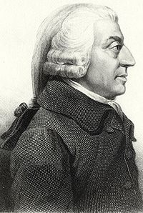
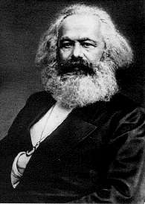
Capitalism vs. Marxism
Adam
Smith
Karl
Marx

Slide 3
Adam Smith
Karl Marx
Born: June 5, 1790
Scottish
Titles (Works produced)
The Theory of Moral Sentiments
The Wealth of Nations
Capitalism
Economist
Social Philosopher
Laissez-faire
Born: May 5, 1818
German
Title (Works Produced)
The Communist Manifesto
Communism
Marxism
Economist
Philosopher
Historian

Slide 4
Capitalist Ideas
Marxist Ideas
Progress results when Individuals follow their own self-interest.
All great movements in history are the result of an economic class struggle. The Industrial Revolution intensified the class struggle
Businesses follow their own self-interest when they compete with one another for the consumer’s money.
The “haves” take advantage of the “have-nots.” Workers are exploited by employers
Each producer tries to provide goods and services that are better and less expensive than those of their competitors.
The community or state should own property and the means of production.
Consumers compete with one another to purchase the best goods at the lowest prices.
The capitalist system will eventually destroy itself. The state will wither away as a classless society develops.
Market economy aims to produce the best products and the lowest prices.
The labor of workers creates profits for employers.
Government should not interfere in the economy.
Distribute goods according to each person’s needs.

Slide 5
Shark Tank Product Pitch
What is your life changing product or service?
Purpose
convincing explanation of who will use the product/service
convincing explanation of why audience will use it
convincing evidence detailing what audience will use it for
convincing explanation of when audience will use it
convincing explanation of where it will be used
Background Knowledge/Research
clear explanation of what product does or how it’s used
clear explanation of what it is made of
clear explanation of other products like it
clear explanation of why this product is better than others
Goals and roles
the product or service is reasonable and realistic
the product or service is doable
clearly divided and fair work load for all members

