Slide 1
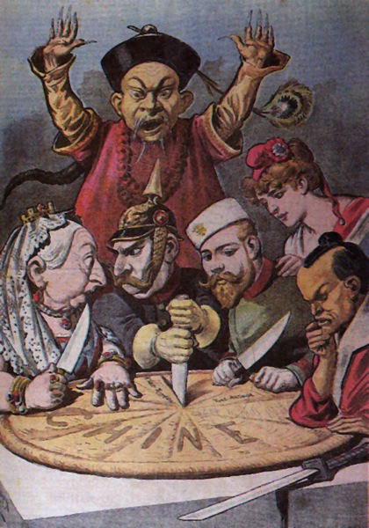
China Resists Outside Influence 12.1 EQ: Why did Europeans establish Spheres of Influence in China rather than colonies, as they did in Africa and other parts of Asia?

Slide 2
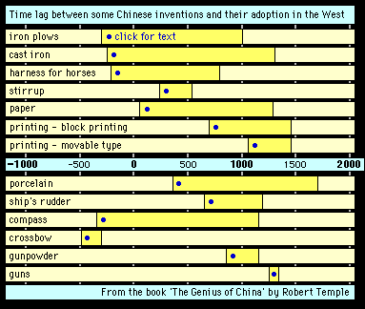
Setting the Stage
Chinas ancient culture gave them Pride, and they looked down on all foreigners.
They were not interested in the Western advances in technology and believed that they had everything they needed.

Slide 3
China and the West
China had a healthy agricultural system and had no need to trade with the west.
Rice was the main crop, also sweet potatoes, peanuts and corn brought in from Spanish and Portuguese traders.
China had extensive mining and manufacturing and was rich in natural resources like salt, tin, silver and iron.

Slide 4
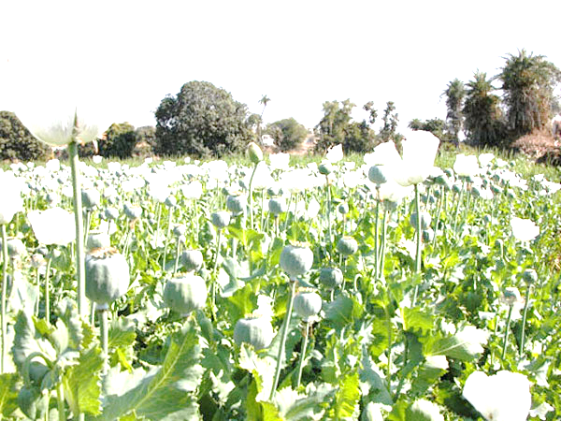
The Tea-Opium Connection
China had little interest in trade and the only trading port was Guangzhou (gwang-joh)
The balance of trade was clearly in Chinas favor, they earned far more for their exports than it spent on imports.
European merchants found their foothold with the trading of the highly addictive narcotic Opium.
Opium had been used for hundreds of years by Chinese doctors as a pain medicine.

Slide 5
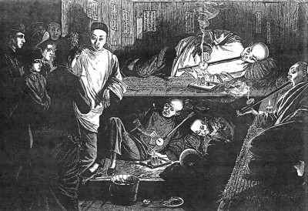
British merchants began smuggling in Opium for non-medicinal use.
By 1835 as many as 12 million Chinese people were addicted to opium.

Slide 6
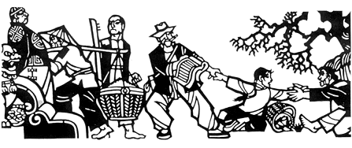
War Breaks Out
The use of Opium caused great problems for China.
The Qing emperors top advisor wrote a letter to England’s Queen Victoria asking her why she allows the trade of Opium when it was illegal in Britain.
The British continued to smuggle in Opium and this led to Opium War of 1839.

Slide 7
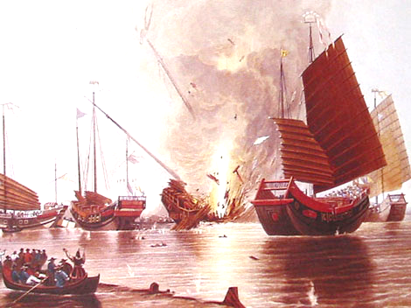
This was mostly a naval war and China’s outdated, old fashioned ships were no match for Britain’s steam powered gunboats.
The Chinese suffered a humiliating defeat and signed the Treaty of Nanjing in 1842.
The Treaty gave Britain the island of Hong Kong.
In 1844 the US and other foreign countries gained extraterritorial rights and were not subject to Chinese laws in Guangzhou and four other port cities.
This angered many Chinese and they grew resentful towards the foreigners.

Slide 8
Growing Internal Problems
China’s population was over 430 million by 1850.
Food production couldn’t keep up and even in good years hunger was widespread.
Many Chinese became discouraged and opium addiction rose steadily.
In addition the Chinese government owed a war debt of about 21 million dollars.
Rebellion against the Qing Dynasty seemed eminent.

Slide 9
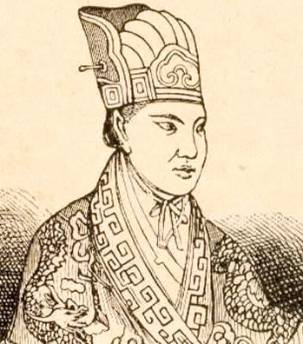
The Taiping Rebellion
Late 1830’s, Hong Xiuquan (hung shee-oo-choo-ahn) began recruiting followers to help him build a “Heavenly Kingdom of Great Peace” in which all of the people would share in China’s vast wealth and no one would live in poverty.
Hong was a charismatic leader who declared himself to be a minor brother of Jesus.
This movement was called the Taiping Rebellion. (Taiping means great peace in Chinese)

Slide 10
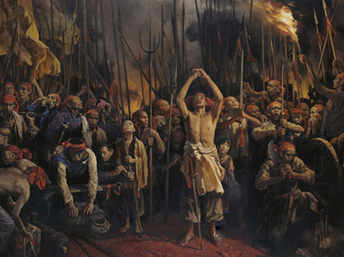
Hong promoted the radical change from the Confucianism to the Christianity, the abolition of the private property, slavery, the abolition of the differences between sexes and the change of the lunar calendar for the solar calendar.
By the 1850’s Hong had organized a massive peasant army of over 1 million soldiers and was able to take control of a large section of southeastern China.
In 1853 Hong captured the major city of Nanjing and made it his capital.
Hong soon withdrew from everyday life and left his family and trusted officials in charge of his kingdom.

Slide 11
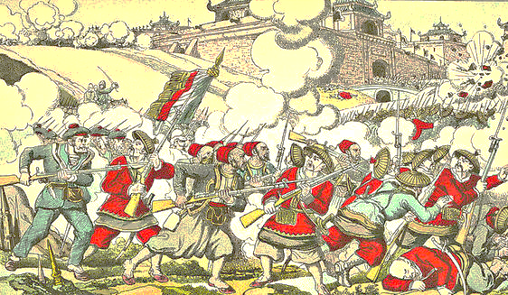
The leaders of the Taiping government constantly fought with one another and made an easy target for invading Qing imperial troops as well as French and British forces.
By 1864 the combination of infighting and outside assaults ended the Taiping government.
China had paid a terrible price, more than 20 million people, died in the rebellion.

Slide 12
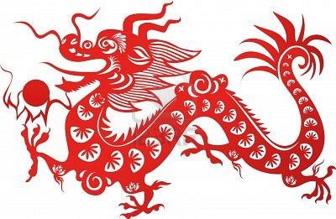
Foreign Influence Grows
The Taiping rebellion and other uprisings put pressure on the Chinese government.
Some officials wanted to adopt western reforms like democracy and capitalism
Others clung to the traditional ways and were reluctant to change.

Slide 13
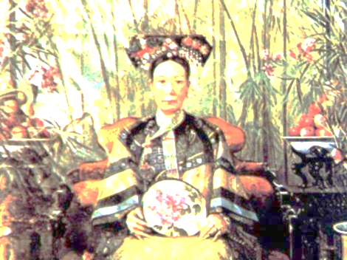
Resistance to Change
From 1862 until 1908 Empress Cixi (too-shee) controlled the Imperial palace.
She was committed to traditional values but did support some reforms.
She updated China’s education system, diplomatic service and military.
China industrialized and built factories to produce steam powered gunboats, rifles and ammunition.

Slide 14
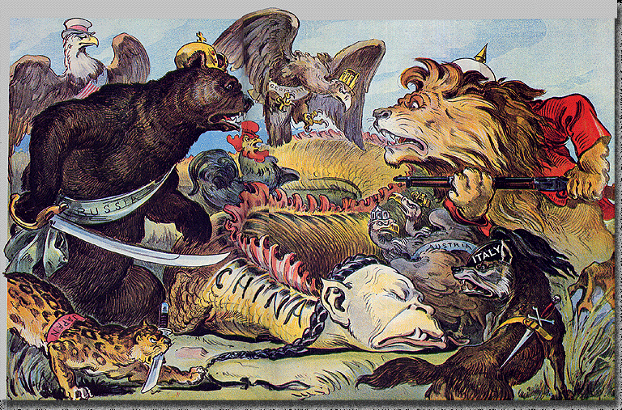
Other Nations Step In
European Nations and Japan were well aware of Chinas troubles and took advantage of the situation and attacked China.
Peace treaties after each conflict gave these nations increasing control over China’s economy.
These Spheres of Influence gave the foreign nations control over trade and investments.

Slide 15
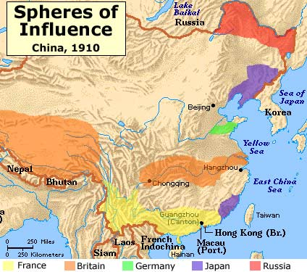

Slide 16
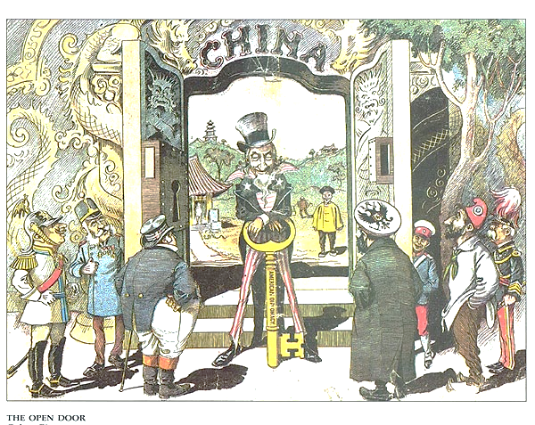
The US was a long time trading partner with China.
They were worried that the European countries would try to carve China into Colonies like they had done with Africa.
This would shut out American merchants and traders.
In 1899 the US declared the Open Door Policy, saying that China would be open to merchants from all countries.
This protected the US’s trading rights and stopped China from being colonized.

Slide 17
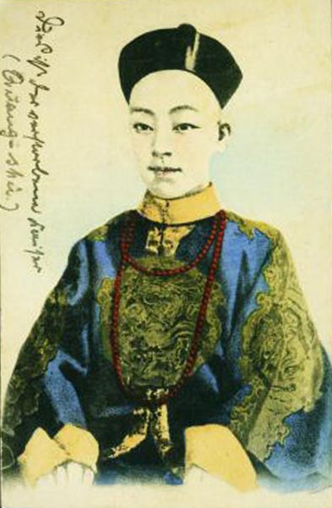
An Upsurge in Nationalism
Humiliated by their loss of power, many Chinese pushed for stronger reforms.
Among these was the young Emperor Guangxu (gwang-shoo).
He called for reorganizing the educational system, strengthening the economy, modernizing the military, and streamlining the government.

Slide 18
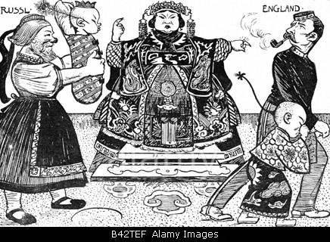
Most Qing officials saw these reforms as a threat to their power and called for Empress Cixi to come back to power.
On her return she placed the Emperor under arrest and took control of the government.
She reversed the reforms and Guangxu’s efforts had no effect.
The people of China were growing more frustrated with their situation and were ready to explode.

Slide 19
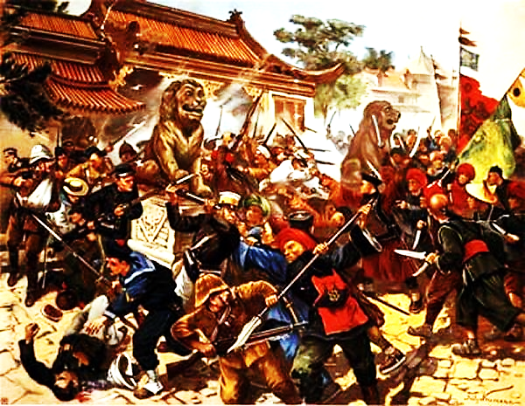
The Boxer Rebellion
Poor peasants and workers resented the special treatment given to foreigners.
They also resented the Chinese who converted to Christianity and had abandoned the traditional Confucianism.
To demonstrate their discontent they formed a secret organization called the Society of Righteous and Harmonious Fists.
This group soon became known as The Boxers.

Slide 20
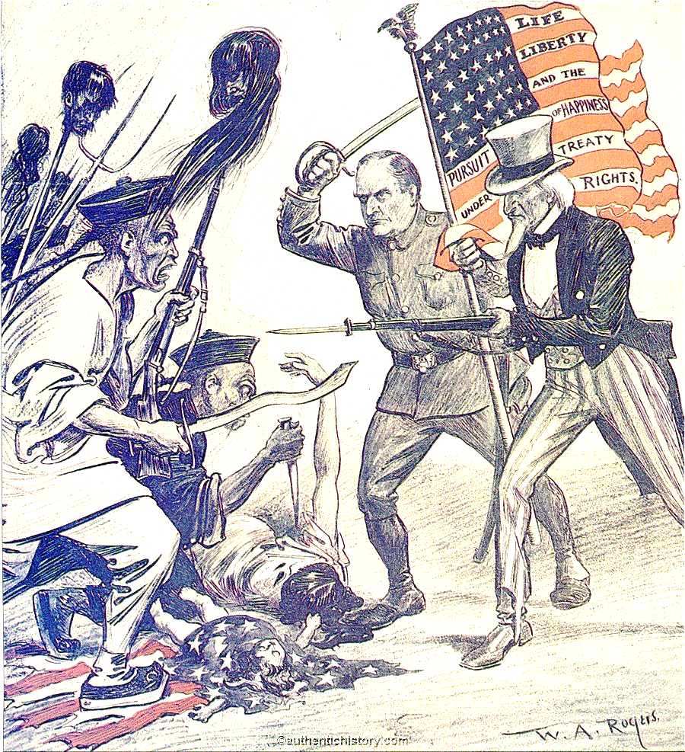
The Boxers were against the Empress’s rule and the privileges given to foreigners.
In the spring of 1900, the Boxers attacked Beijing and surrounded the European section shouting “death to the foreign devils”.
They kept their siege up for several months and the empress said she supported the Boxers but did not provide any military support.
In August a multinational force marched into Beijing and quickly defeated the Boxers.

Slide 21
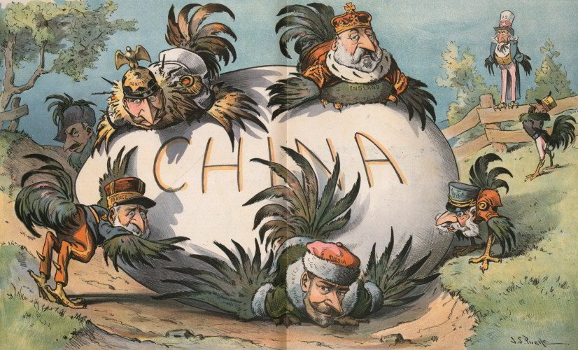
Despite the failure of the Boxer Rebellion, a new sense of Nationalism had emerged in China.
The people realized that their country had to stand up to foreign intervention.
The government must become more responsive to their needs.

Slide 22
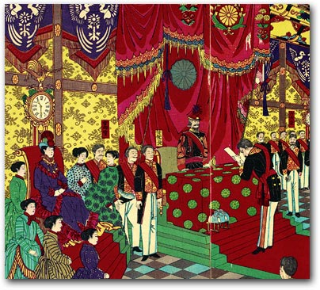
The Beginnings of Reform
Even the Empress realized that China needed to make profound changes in order to survive.
In 1905 she sent a group of officials on a world tour to study to operation of different forms of government.
They returned in 1906 and suggested that China restructure its government based on the Constitutional monarchy of Japan.

Slide 23
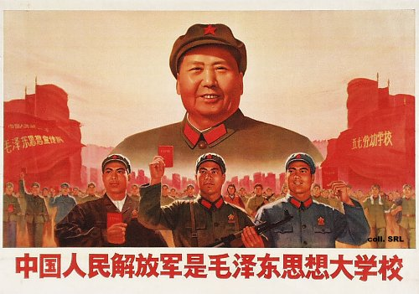
The Empress accepted the recommendation and began making slow reforms.
However the reforms never happened.
China continued to face unrest during the next 4 decades.
It will not be until after World War II, when China becomes communist that a sense of stability will occur.

