Slide 1
Good Afternoon
Please find your comrades, have a seat and take out your notes from yesterday
Caleb Alison Ashley Danny | Nadia Dyonna Anthony Joe | Ryan Emma Paola Jack
Jaret Kenny Alexa Whitney | Brooke Haylee Reid Michael | Chad Madi W Olivia Jacob

Slide 2
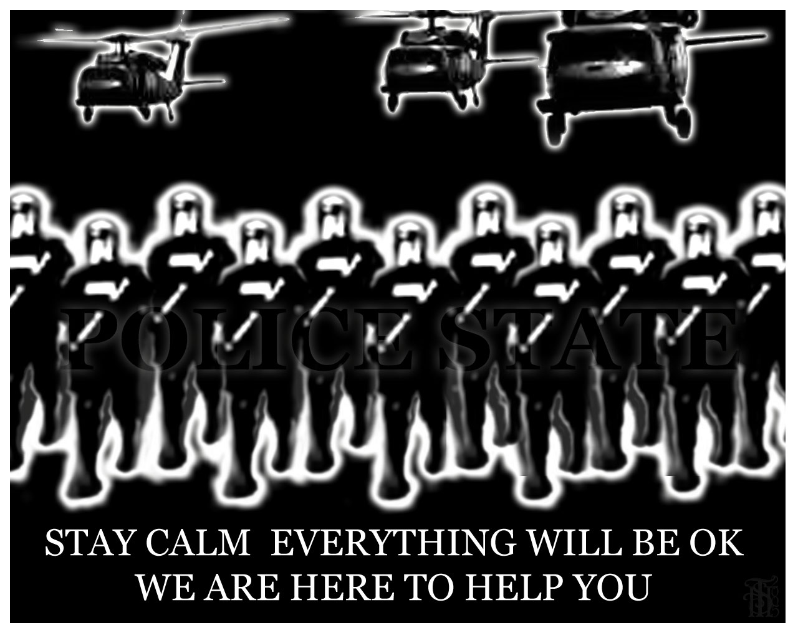
Government of Total Control
Provides a sense of security and a direction for the future.

Slide 3
Police Terror
What is the purpose of Police in our society?

Slide 4
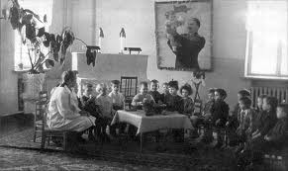
Indoctrination
Instruction of Govt.’s beliefs to mold peoples minds.

Slide 5
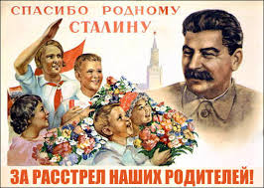
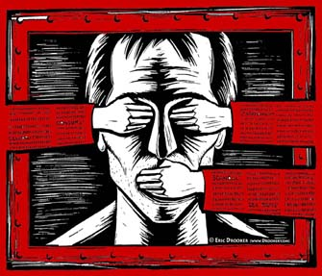
Propaganda & Censorship

Slide 6
Persecution
Religious or Ethnic groups are targeted as enemies of the state to blame for things that go wrong.

Slide 7
Seven Key Traits
Totalitarianism
Make a Chart on a separate sheet of paper or in your notes.

Slide 8
Fictional Totalitarian State
In your groups:
Invent: Name of your state, identify the location, make up a name for the dictator, and list the effects of totalitarianism on individual lives.
Task: How would your regime/leader change a democratic and free country into one led by a dictator.

Slide 9
How Stalin did it
Police State
Russian Propaganda and Censorship
Education and Indoctrination
Religious Persecution
League of the Militant Godless
Communism ideals to replace religion

Slide 10
