Slide 1
Good Afternoon
Please sit with your groups and take out your notes from yesterday.

Slide 2
Fictional Totalitarian State
In your groups:
Invent: Name of your state, identify the location, make up a name for the dictator, and list the effects of totalitarianism on individual lives.
Task: How would your regime/leader change a democratic and free country into one led by a dictator.

Slide 3
How Stalin did it
Police State
Russian Propaganda and Censorship
Education and Indoctrination
Religious Persecution
League of the Militant Godless
Communism ideals to replace religion

Slide 4
Propaganda through Art
Propaganda- used negatively to show false or misleading types of persuasion.
Relies on tactics that range from factual evidence to outright lies.
All governments use some sort of propaganda to generate support for policies, political parties, and candidates for office.

Slide 5
Why was it so effective in the Soviet Union?
Appealed to the idealism of building the worlds first soviet state.
In the 1930’s workers felt proud to have jobs and be contributing while the rest of the world was suffering the Great Depression.
Workers received benefits such as free education, free medical care and old-age pensions.

Slide 6
Why is recognizing propaganda important in making intelligent decisions?

Slide 7
Persuasive Techniques
(Otherwise known as: PROPAGANDA)
PROPAGANDA: techniques used to influence opinions, emotions, attitudes or behavior.

Slide 9
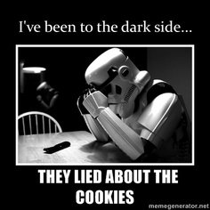
What is persuasion?
Generally an appeal to emotion, not intellect.
An attempt to change your behavior
It attempts to “guide your choice”

Slide 10
Who uses propaganda?
Military
Media
Advertisers
Politicians
You and I!!!

Slide 11
Propaganda Techniques
Bandwagon Technique
Testimonial
Loaded Word
Misuse of statistics
Name calling or stereotyping
Plain Folks
Snob Appeal
Transfer

Slide 12
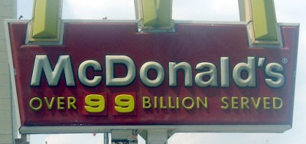
Bandwagon Technique
Everyone is doing it! You should too!!!

Slide 13
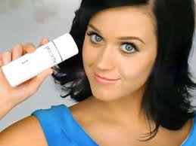
Testimonial
Testimonials are quotations or endorsements which connect a famous or respectable person with a product or item.

Slide 14
Loaded Word
Use “loaded” words like . . .
new
improved
best

Slide 15
Misuse of Statistics
When the statistics are based on a falsehood.

Slide 16
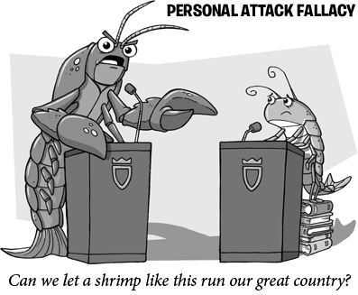
Name Calling or stereotyping
Smears or damages an opponent
Often used by politicians

Slide 17
Snob Appeal
aims to flatter
Makes insinuation that this product is better than others.
“avant garde” ahead of the times.

Slide 18
Plain Folks
Makes the leaders look like
Plain folks (mom and pop style).
a convincing method to show they are just common people.
Opposite of snob appeal

Slide 19
Transfer
-Feelings (good or bad)
are transferred to something else.
Transfer tries to make you view something in the same way as they view something else.
In the Kerry vs. Bush campaign, an internet email circulated showing similar physical characteristics between John Kerry and Frankenstein’s monster.

Slide 20
What type of propaganda technique is used in the following ad?
Bandwagon
Loaded Words
Testimonial
Name-Calling
Plain Folks
Snob Appeal
Misuse of Statistics
Transfer
B. Loaded word

Slide 21
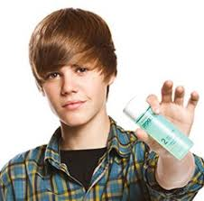
What type of propaganda technique is used in the following ad?
Bandwagon
Loaded Words
Testimonial
Name-Calling
Plain Folks
Snob Appeal
Misuse of Statistics
Transfer
C. Testimonial

Slide 22
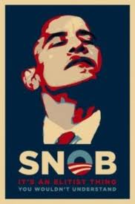
What type of propaganda technique is used in the following ad?
Bandwagon
Loaded Words
Testimonial
Name-Calling
Plain Folks
Snob Appeal
Misuse of Statistics
Transfer
D. Name Calling

Slide 23
What type of propaganda technique is used in the following ad?
Bandwagon
Loaded Words
Testimonial
Name-Calling
Plain Folks
Snob Appeal
Misuse of Statistics
Transfer
A. Bandwagon

Slide 24
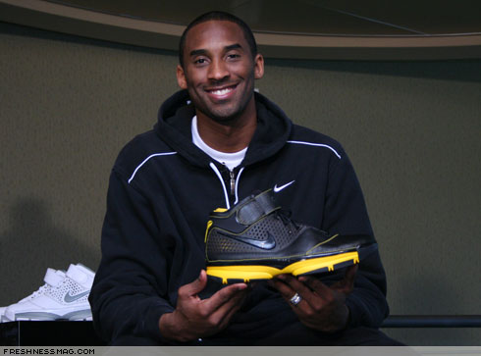
What type of propaganda technique is used in the following ad?
Bandwagon
Loaded Words
Testimonial
Name-Calling
Plain Folks
Snob Appeal
Misuse of Statistics
Transfer
C. Testimonial

Slide 25
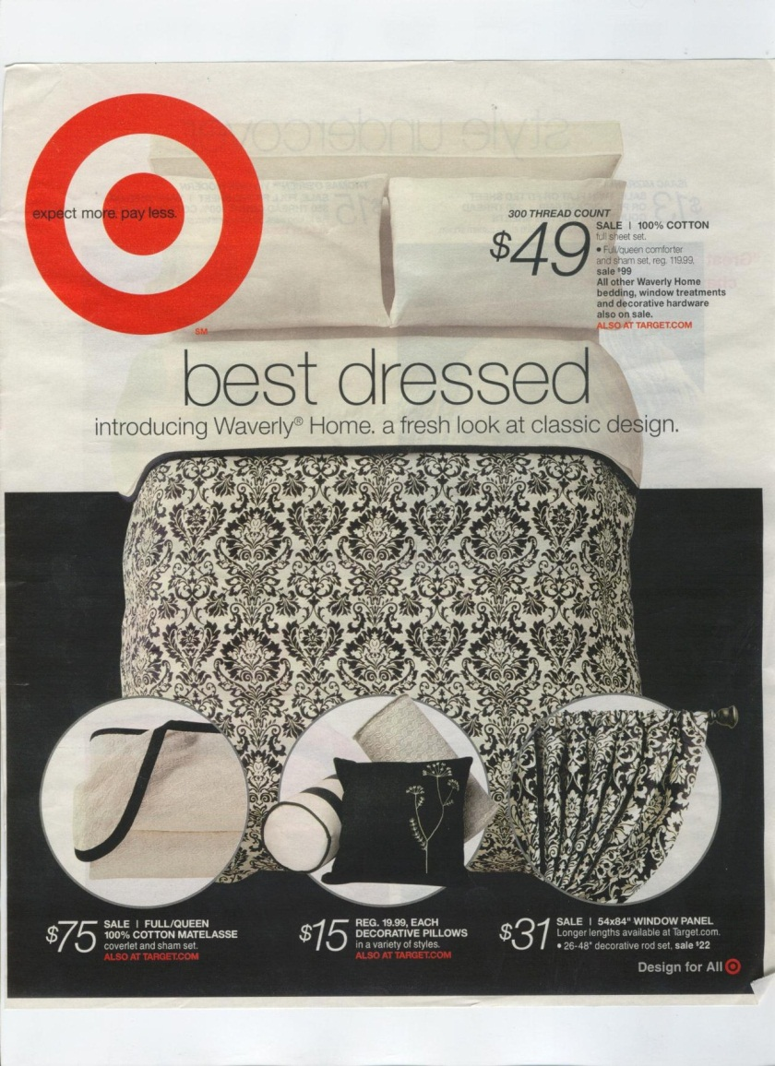
What type of propaganda technique is used in the following ad?
Bandwagon
Loaded Words
Testimonial
Name-Calling
Plain Folks
Snob Appeal
Misuse of Statistics
Transfer
Loaded Word

Slide 26
What type of propaganda technique is used in the following ad?
Bandwagon
Loaded Words
Testimonial
Name-Calling
Plain Folks
Snob Appeal
Misuse of Statistics
Transfer
Loaded Word

Slide 27
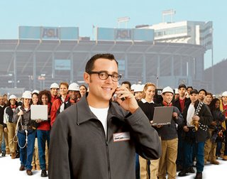
What type of propaganda technique is used in the following ad?
Bandwagon
Loaded Words
Testimonial
Name-Calling
Plain Folks
Snob Appeal
Misuse of Statistics
Transfer
Bandwagon

Slide 28
What type of propaganda is this?
Bandwagon
Loaded Words
Testimonial
Name-Calling
Plain Folks
Snob Appeal
Misuse of Statistics
Transfer
95% of homework assigned is busy work and is not beneficial to the student!
Misuse of Statistics

Slide 29
What type of propaganda technique is used in the following ad?
Bandwagon
Loaded Words
Testimonial
Name-Calling
Plain Folks
Snob Appeal
Misuse of Statistics
Transfer
Snob Appeal

Slide 30
What type of propaganda is this?
Bandwagon
Loaded Words
Testimonial
Name-Calling
Plain Folks
Snob Appeal
Misuse of Statistics
Transfer
Testimonial

Slide 31
What type of propaganda is this?
Bandwagon
Loaded Words
Testimonial
Name-Calling
Plain Folks
Snob Appeal
Misuse of Statistics
Transfer
D. Name -Calling

Slide 32
What type of propaganda is this?
Bandwagon
Loaded Words
Testimonial
Name-Calling
Plain Folks
Snob Appeal
Misuse of Statistics
Transfer
F. Snob appeal

Slide 33
What type of propaganda is this?
Bandwagon
Loaded Words
Testimonial
Name-Calling
Plain Folks
Snob Appeal
Misuse of Statistics
Transfer
B. Loaded Words

Slide 34
Propaganda Poster
Create a Poster that demonstrates one of the types of Propaganda.
Purpose- expose the evil, weak and negative aspects of chico high or
GLORIFY the POWER, BEAUTY and POSITIVE ASPECTS of PLEASANT VALLEY.
On the back of your poster identify the type, the intended message and why it is an effective piece of propaganda.

Slide 35
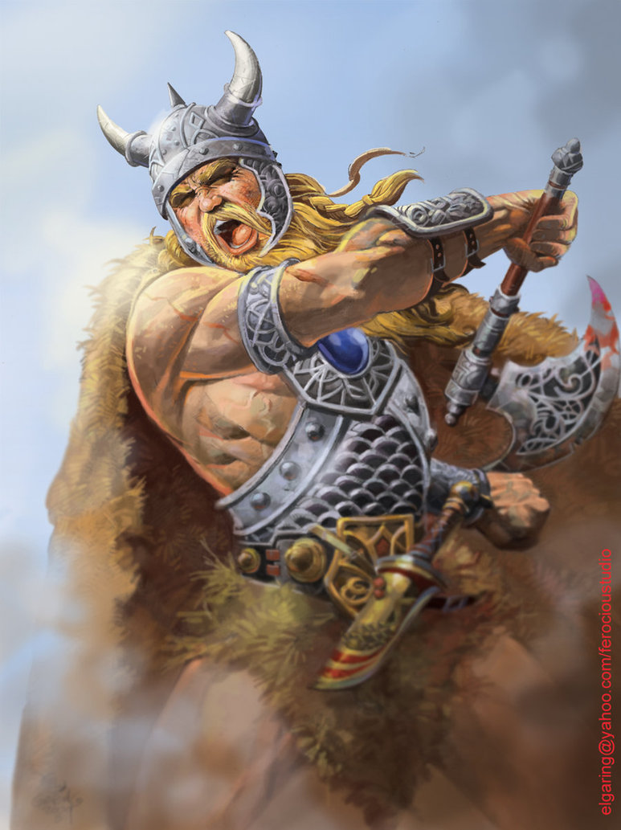
Loaded Words
Its intended to show that the PV Viking is powerful and is overpowering the panther. The word Dominate reflects back on the previous series of games in which PV swept Chico High on all levels of Basketball.
Its effective because the image is striking and there is truth to the message that PV did win all the games in the last series.
Dominate

