Slide 1
Good Afternoon
Please find your new comrades and have a seat
Caleb Alison Ashley Danny | Nadia Dyonna Anthony Joe | Ryan Emma Paola Jack
Jaret Kenny Alexa Whitney | Brooke Haylee Reid Michael | Chad Madi W Olivia Jacob

Slide 2
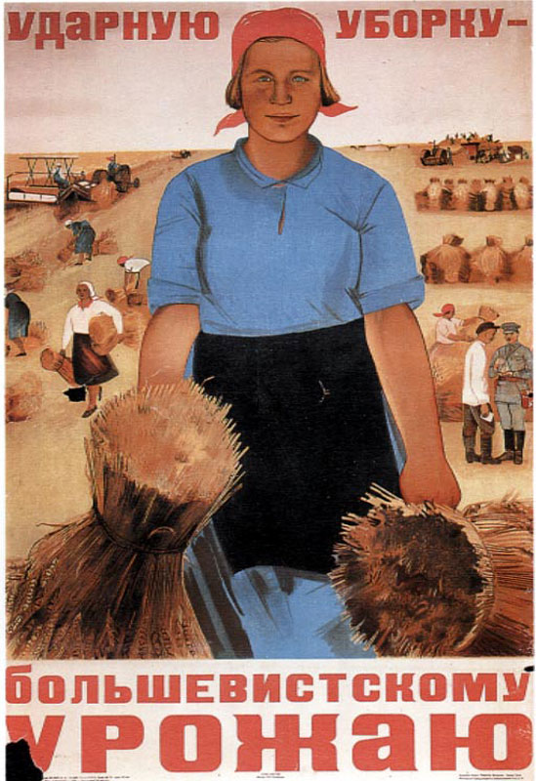
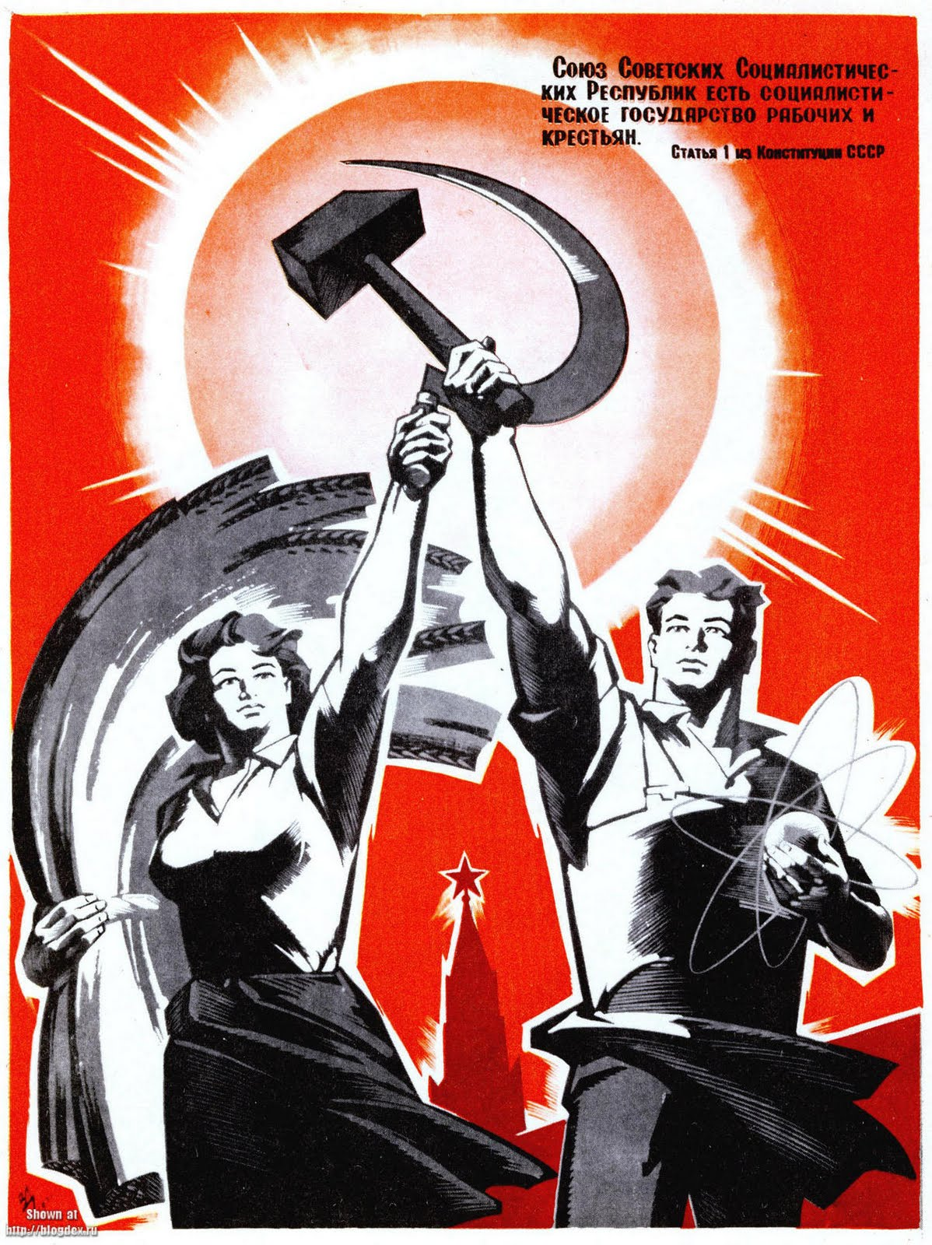
Examine the posters of these soviet workers. What is most striking about them? What are the slogans written on the posters?
"Let's put in an exemplary gathering up to the Bolshevik harvest"
“The Soviet Union is the socialist government of workers and peasants.”

Slide 3
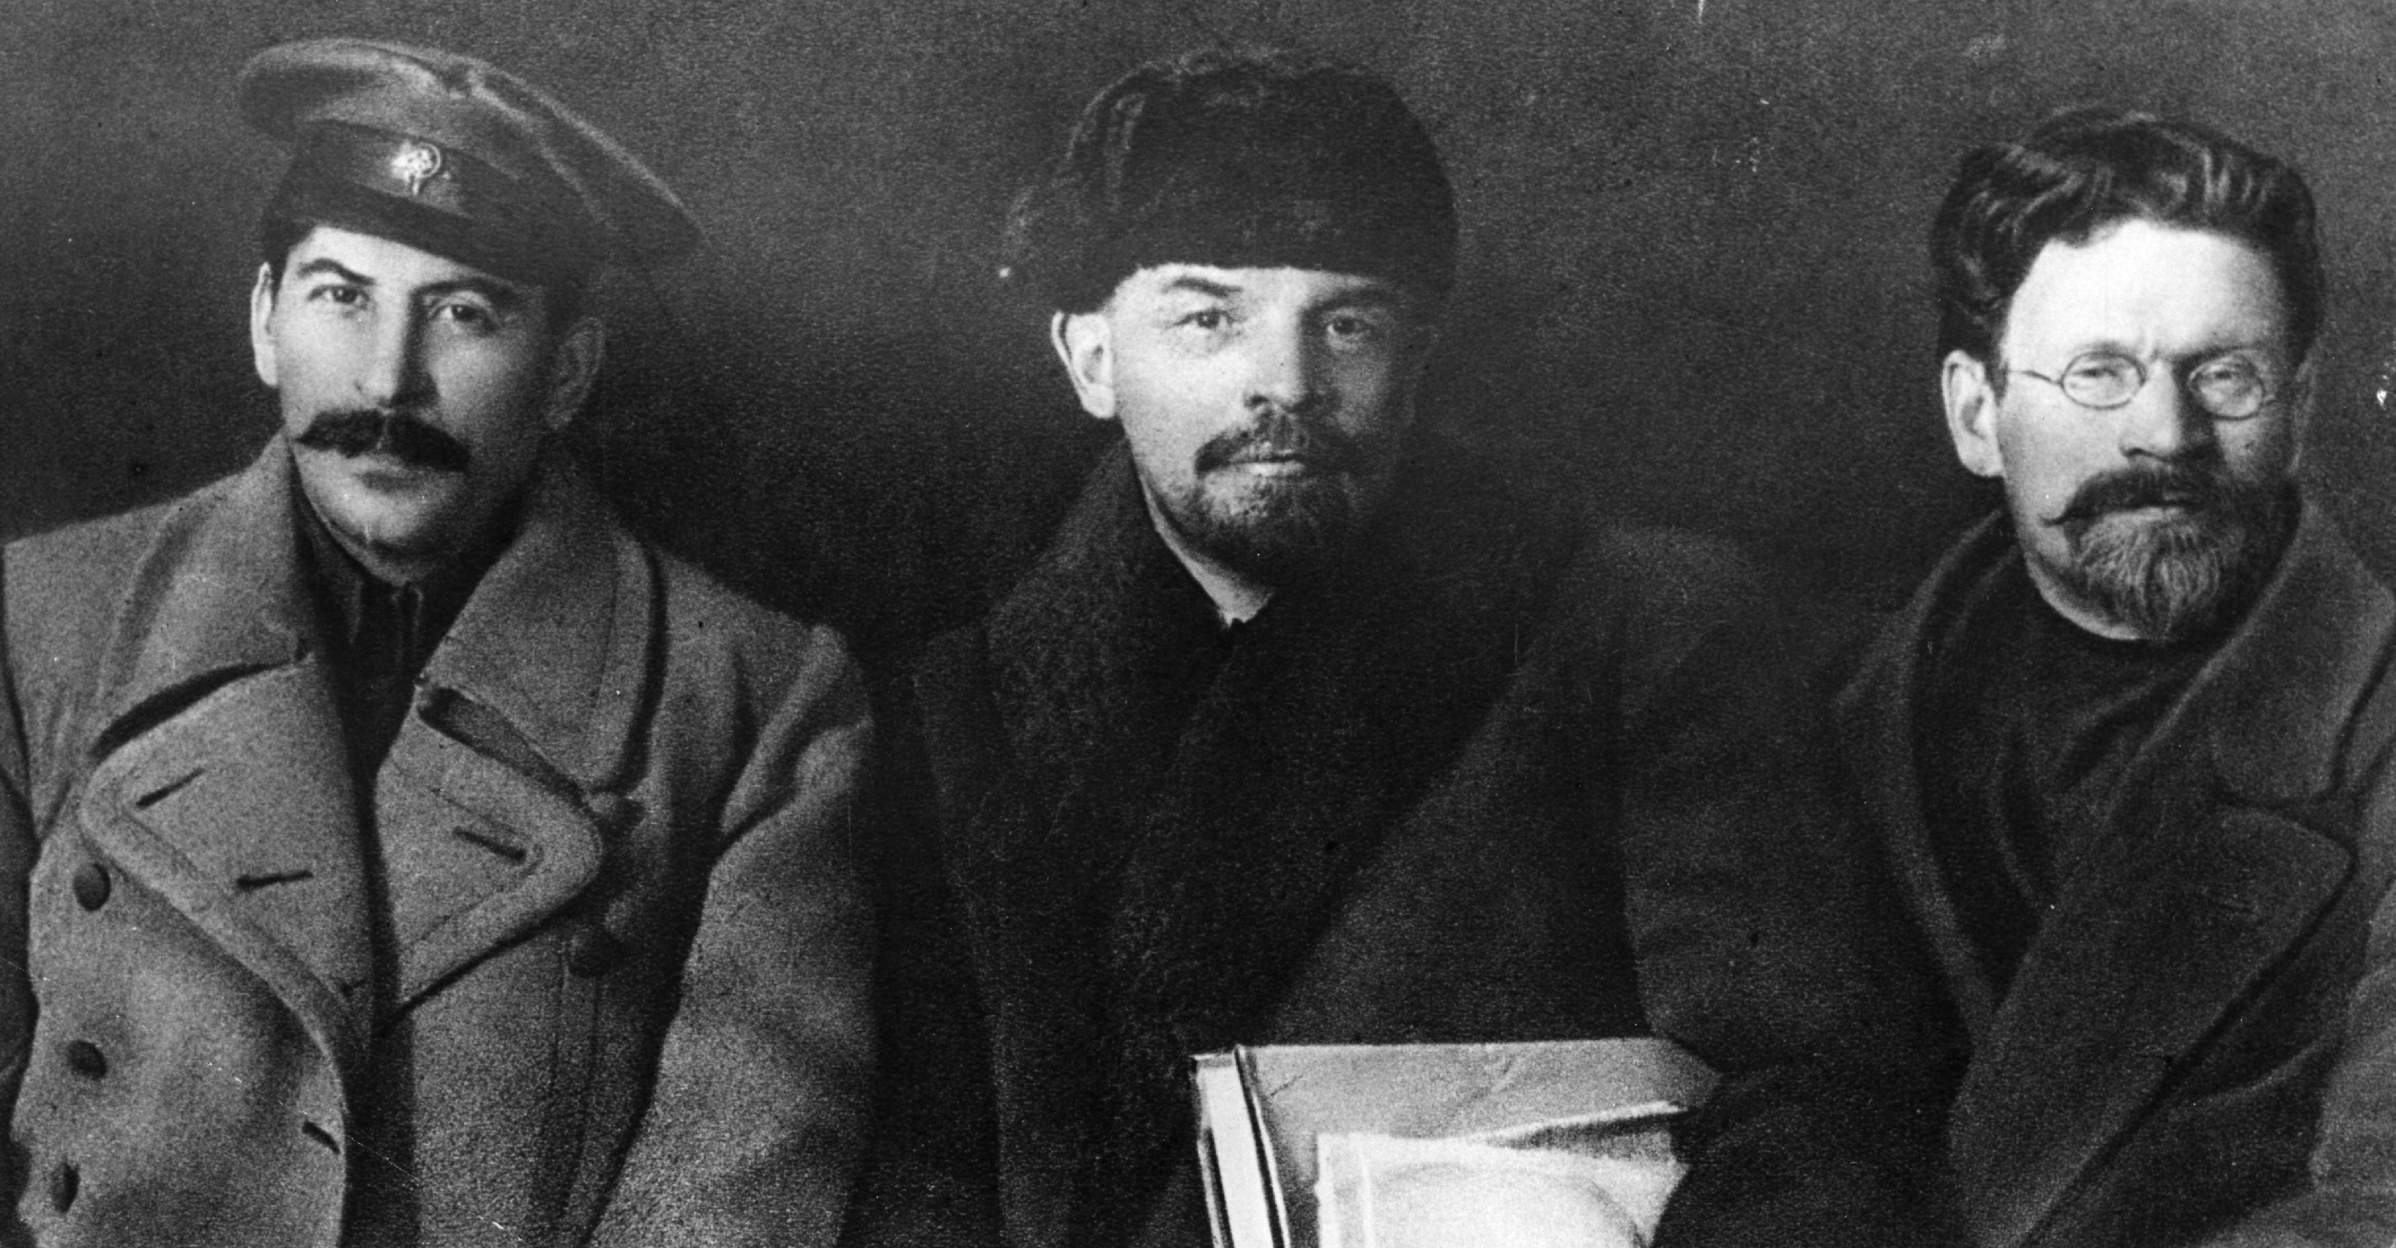
Stalin Lenin Trotsky

Slide 4
Who would you rather have as a leader?
Brains or Muscles?
What characteristics make up an effective leader?

Slide 5
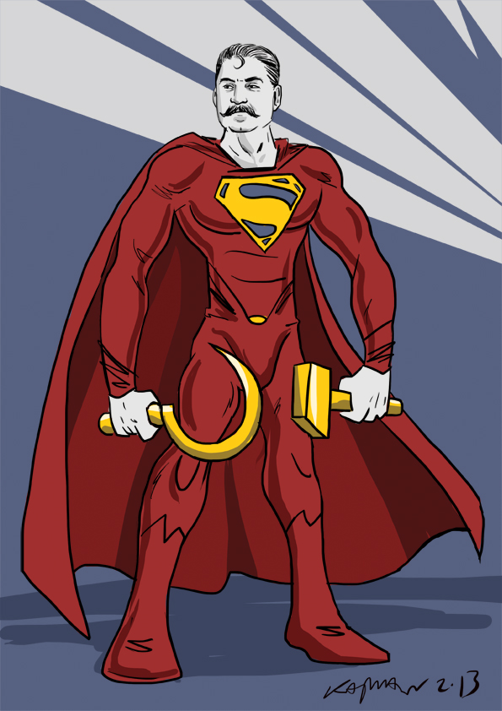
Stalin becomes Dictator
Stalin = Man on steel
Cold, hard, impersonal
“Comrade Stalin has concentrated enormous power in his hands, and I’m not sure that he always knows how to use that power with sufficient caution.” -Lenin

Slide 6
What occurs when people have more power than they can handle?
What examples can you come up with that show that “great power comes with great responsibility”?

Slide 7
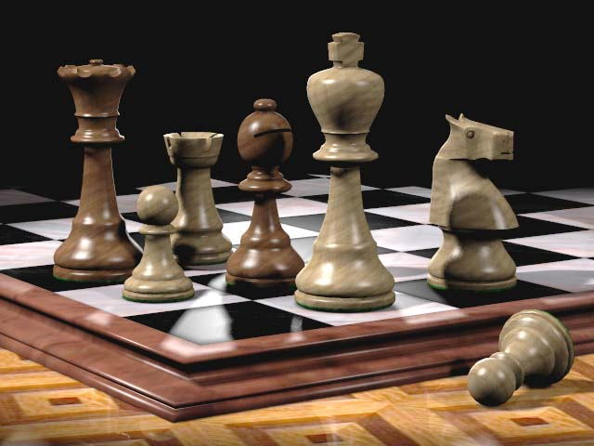
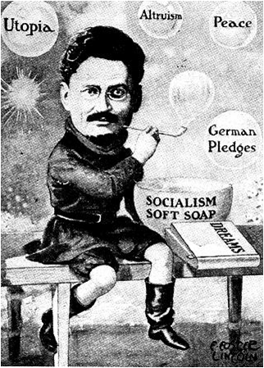
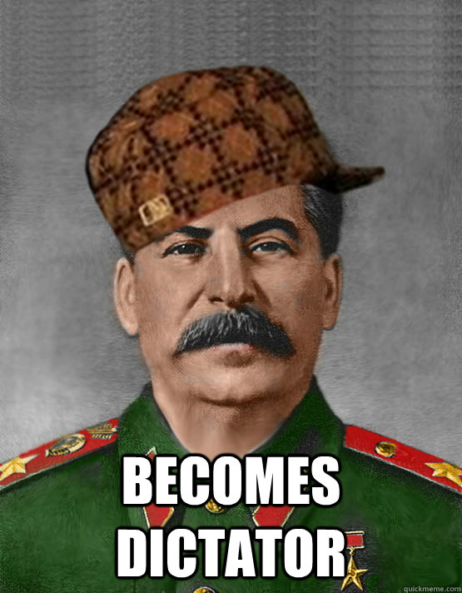

Slide 8
Why do you think Stalin forced Trotsky into Exile?

Slide 9
Stalin Builds a Totalitarian State
Lenin and Trotsky = worldwide revolution
Stalin = Russian development
“socialism in one country”
Transforms SU into Totalitarian state
Totalitarianism - a government that takes total, centralized state control over every aspect of public and private life.

Slide 10
Totalitarian leaders appear to provide a sense of security and to give a direction for the future.
Western democracies-
reason, freedom, human dignity, and the worth of the individual.

Slide 11
What would it be like not to have the freedom to choose what you buy, where you work, what you eat, and what you say?
What would you miss most and why?

Slide 12
Stalin Seizes Control of the Economy
Lenin’s NEP- mix of free enterprise and state control
Stalin’s plan- total state control
Command Economy- State makes all the economic decisions
Political leaders identify needs and determine how to fulfill them.
Revolutions in industry and agriculture

Slide 13
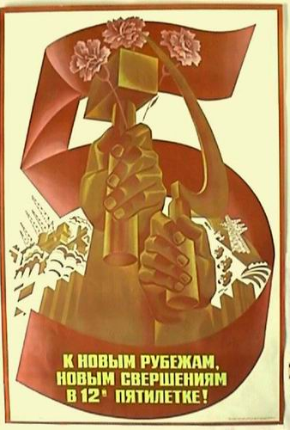
An Industrial Revolution
Five year plan- develop the country economically
“We are fifty or a hundred years behind the advanced countries. We must make good this distance in ten years. Either we do it or we shall be crushed.”
-Stalin

Slide 14
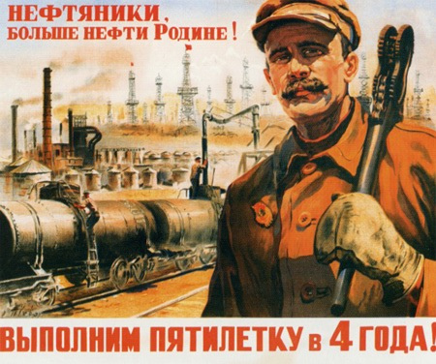
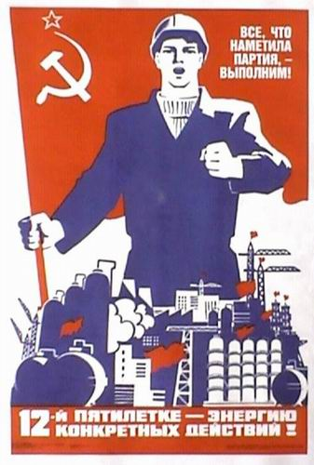
Impossibly high quotas
Coal
Steel
Electricity
Limits the production of consumer goods
Severe shortages of housing, food, clothing, and other necessary goods.

Slide 15
Why did Stalin limit the production of consumer goods?
How would you react if you could no longer go to the mall and buy any types of clothes you prefer?

Slide 16
Total government control!
Every aspect of the workers life
Officials chose workers, assigned jobs, determined hours.
Workers need permission to move.
Secret Police would imprison or execute those who did not contribute to the economy.
Takes a great toll on people’s personal lives.
Many divorces and family break ups.

Slide 17
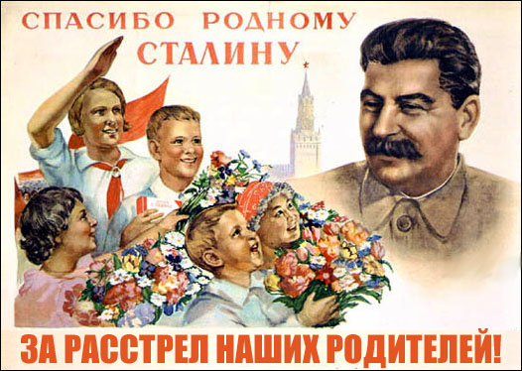
Grim methods = fantastic economic results!
Most targets fell short but they made impressive gains
From 1928 to 1937 production increased more than 25%.
Thanks
Stalin!

Slide 18
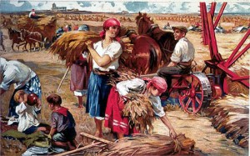
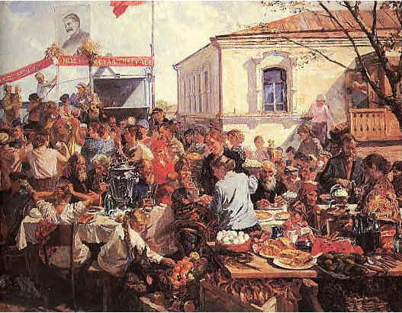
An Agricultural Revolution
Also successful but far more brutal
1928 government began seizing 25 million privately owned farms.
Collective farms
Hundreds of families work, producing food for the state.
Modern machinery =
increase production,
reduce the number of workers.

Slide 19
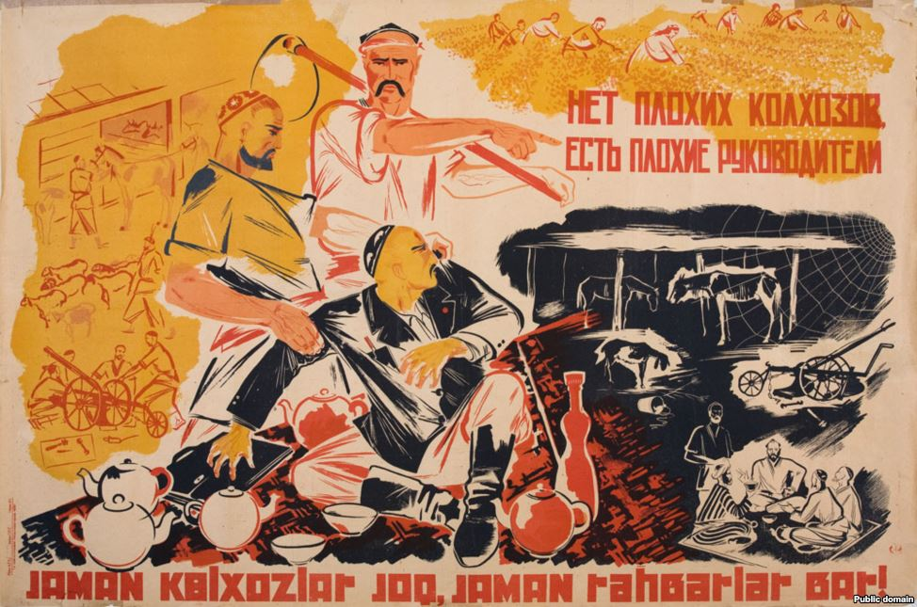
Peasants resisted
Livestock killed, crops destroyed in protest
Terror and violence used to force peasants to work.
Between 5-10 million peasants died as a result of the agricultural revolution
Millions more exiled to Siberia.
“There are no bad collective farms or bad managers”

Slide 20
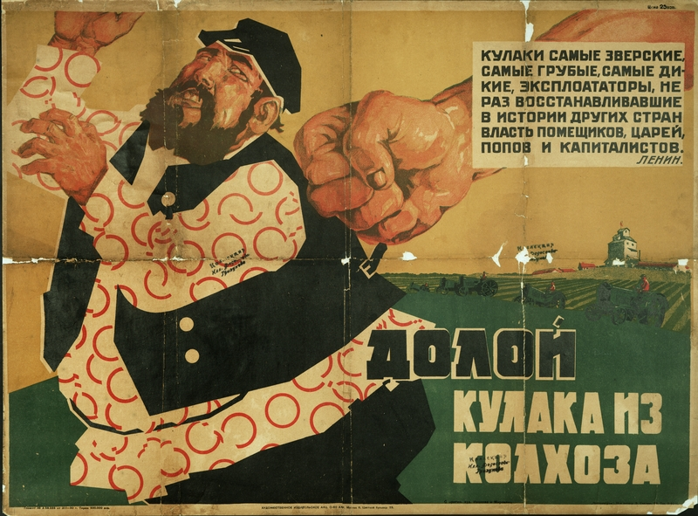
Kulaks resistance
Wealthy peasants, had land
Government decides to eliminate them.
Thousands killed or sent to work camps.

Slide 21
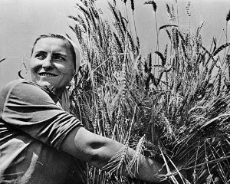
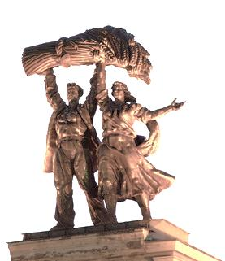
By 1938 90% of Peasants lived on CF’s
Twice as much wheat production it had in 1928 before collective farming.

Slide 22
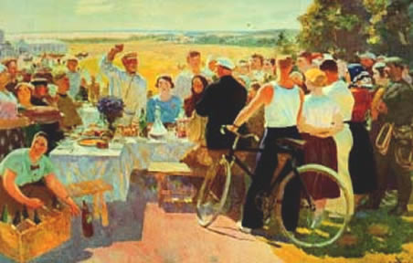
Why wouldn’t people want to live on a collective farm?

