Slide 1
Antigone
Everything you need to know to get started

Slide 2
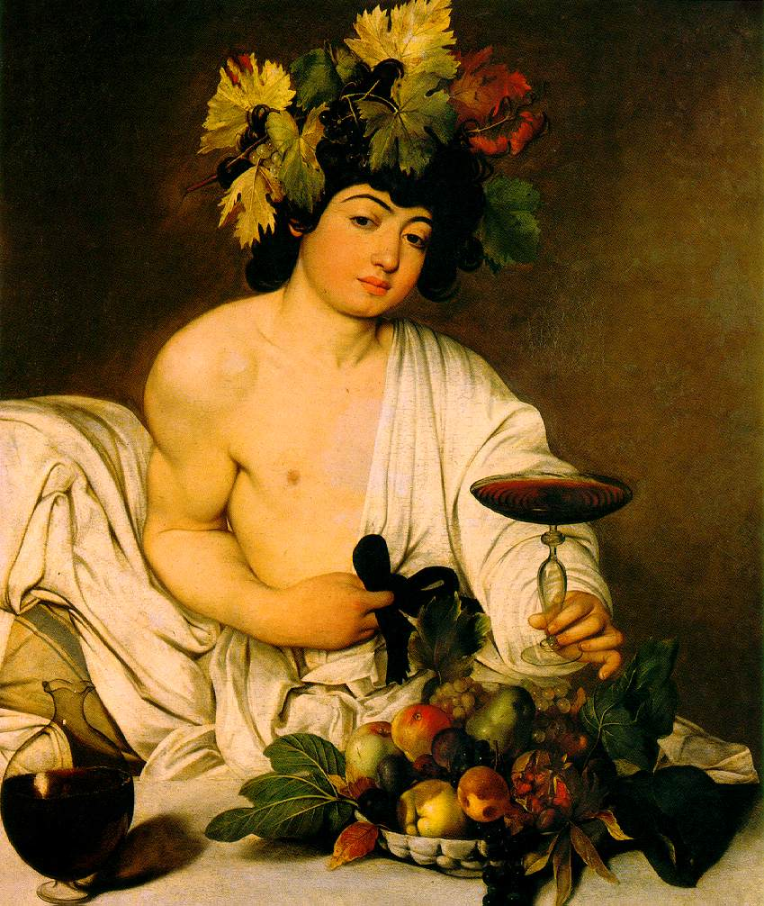
History of Greek Theater
Theater in the Western World can be traced back to ancient Greece (c. 500 B.C.)
Greek drama was presented exclusively at festivals honoring Dionysus.
Dionysus was the god of wine and fertility; his blessing was sought to ensure the fertility of human beings and the land.

Slide 3
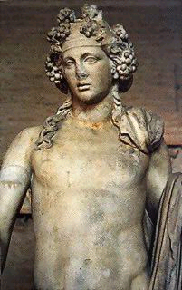
Greek Amphitheatre
Plays were usually staged during the festival of Dionysus
Crowds of 15,000 people regularly attended the performances, and even criminals were released from prison in order to see the plays.

Slide 4
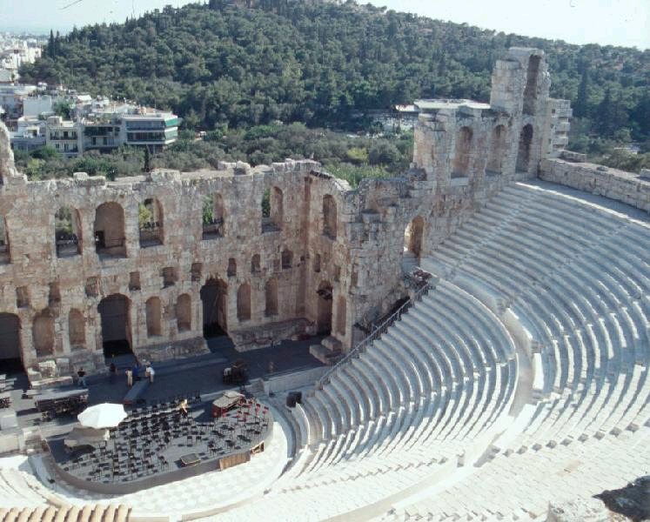
Greek Amphitheatre
Plays were written to be performed in public hillsides at the great Theater of Dionysus.
Hillsides provided a natural semicircle or amphitheater

Slide 5
Greek Amphitheatre
A. Theater-audience
B. Orchestra- base of theater where the actors and chorus perform
C. Altar-for Dionysus (God of Wine and Fertility)
D. Skene-dressing room
A
B
C
F
F
D

Slide 6
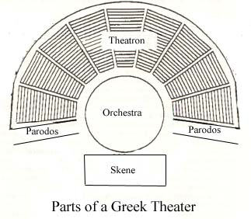
Greek Amphitheatre
The Theater of Dionysus looked like a semicircular football stadium.
The seats were carved out of stone on a hillside, known as the “theatron” or theatre.
At the bottom was a performance area divided into two parts.
In the front was a rounded orchestra - a fairly large space where the chorus sang and danced around the remnant of an altar.

Slide 7
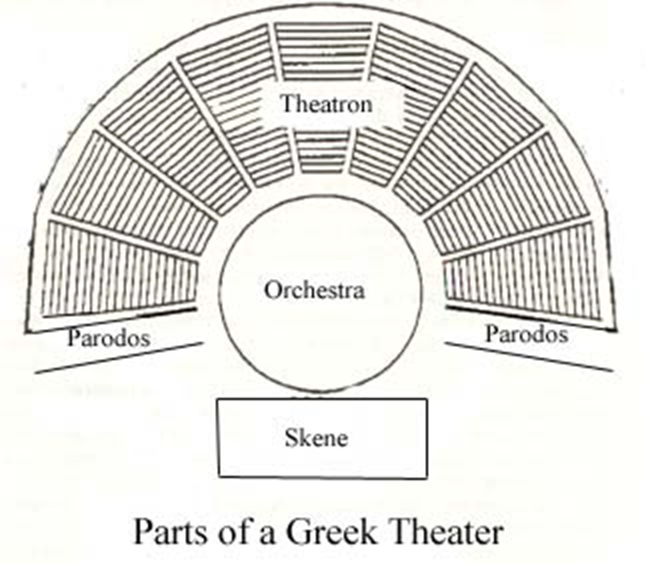
Greek Amphitheatre
Parodos - entrance passage
Proscenium - the level area in front of the skene on which most of the play's action took place
Notes:
Pair-uh- dahs

Slide 8
Greek Amphitheatre
Behind the orchestra, proscenium and altar, was a skene - a small shed like building.
The skene was used as a dressing room
A skene might be painted to show scenes

Slide 9
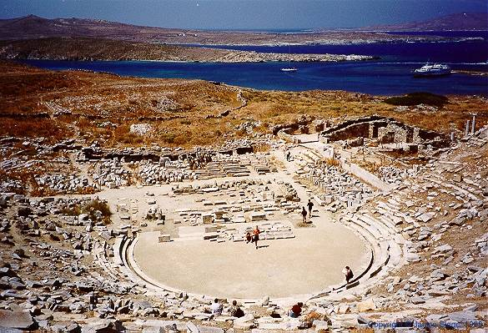

Slide 10
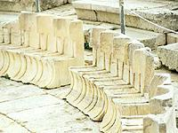

Slide 11
The Performers
The performers in Greek theater can be divided into 4 categories:
Actors
Chorus
Supernumeraries (non-speaking extras)
Musicians

Slide 12
Actors
By around 430 B.C. the rules of the contests restricted the number of speaking actors to three for each playwright.
This rule did not restrict the number of roles to three because a single actor could play several roles.
The actors were all men—they played both the male and female roles

Slide 13
The Actors
Behind the orchestra was a platform where
The actors spoke their lines from behind huge masks.
To aid in viewing, actors wore oversized, well- padded costumes, and boots with raised soles (stilts).
These masks had exaggerated mouthpieces that amplified the actors’ voices. Chanting also help to amplify their voices.
Many masks were stylized into familiar character types that were easily recognized by the audience.

Slide 14
The Chorus
The tragic chorus was composed of 15 men
Also wore masks
The choruses usually performed in unison, but sometimes as two subgroups that responded to each other.
All the actors were men, and the choruses were well-trained boys.

Slide 15
The Chorus
They entered after the prologue.
They performed choral odes (songs and dances) between the episodes (scenes).
Ode- indicates the end of a scene - also used to provide the chorus’s response to the proceeding scene.
Strophe and Antistrophe
Playwrights were assigned a “choragus” – a leader of the chorus who was a wealthy citizen paid to train and costume the chorus and musicians.
Notes:
Choregus (ker-ray-gus)

Slide 16
The Chorus
To provide background information for the audience; to express the author's point of view
To talk to and give advice to the main characters
To interpret important events that occur in drama. They help to establish the mood and heighten the dramatic effects.
To add color, movement, and spectacle.
To serve as the ideal spectator, reacting as the author would want

Slide 17
Masks
All of the performers, except musicians, wore masks. The masks served several purposes:
Facilitated rapid change of roles.
Made it easier for male actors to play female characters.
Helped the actor in assuming roles of different types.

Slide 18
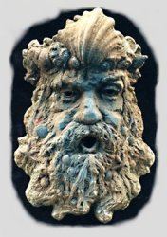
Sample Greek Theatre Masks

Slide 19
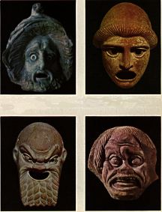

Slide 20
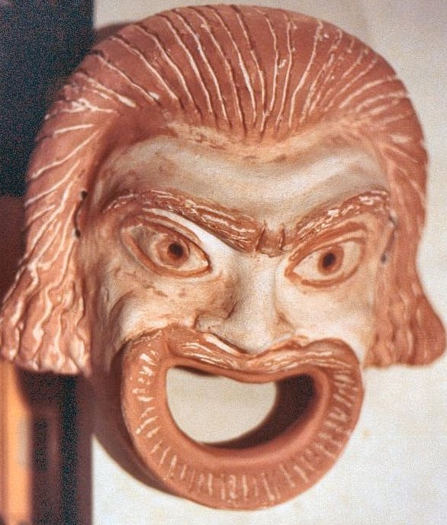

Slide 21
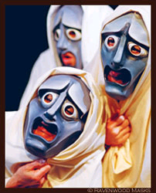

Slide 22
Structure of the Play
Prologue - the opening scene - the background of the story is established, usually by a single actor or in a dialogue between two actors.
Parodos - the entrance of the chorus, usually chanting a lyric which bears some relation to the main theme of the play.
Episode – the counterpart of the modern act or scene - the plot is developed through action and dialogue between the actors, with the chorus sometimes playing a minor role.
Notes:
Parodos- par-uh-dos

Slide 23
Ode - Each scene is followed by an ode. These odes serve both to separate one scene from the next, (since there were no curtains), and to provide the Chorus’s response to the preceding scenescene.
Exodos - the final action, ended by the ceremonial exit of all the players.

Slide 24
Genre
Antigone is a tragedy.

Slide 25
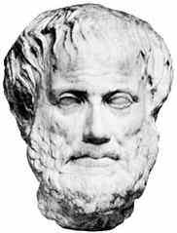
Aristotle’s View of Tragedy
Aristotle, the Greek philosopher, was the first to define tragedy, and critics have argued about it ever since.
Aristotle’s definition of tragedy:
to arouse pity and fear in
the audience so that they may
be purged, or cleansed, of
these unsettling emotions

Slide 26
Aristotle’s View of Tragedy
Catharsis:
emotional purging
a strangely pleasurable sense of emotional release we experience after watching a great tragedy
for some reason, we usually feel exhilarated, not depressed, after a tragedy

Slide 27
Aristotle’s View of Tragedy
According to Aristotle, we can only feel pity and fear after a tragedy if there is a tragic hero or heroine.

Slide 28
Aristotle’s View of Tragedy
Tragic hero/heroine:
A character who is neither completely good nor completely bad but rather somewhere in the middle. He/she does have good intentions.
Someone “who is highly renowned and prosperous,” which in Aristotle’s day meant a member of a royal family or someone who held a high or elevated place in society.

Slide 29
Aristotle’s View of Tragedy
Tragic hero/heroine continued:
*The character must possess a flaw (tragic flaw) in his/her personality that is taken to an extreme and impairs his/her judgment.
*This tragic flaw leads to the hero’s/ heroine’s own downfall (a major catastrophe).
*By the end of the play, the tragic hero recognizes his/her own error, accepts its tragic consequences, and is humbled.

Slide 30
Aristotle’s View of Tragedy
As the audience, we feel:
PITY: the hero’s punishment is too harsh for his crime, and he is a suffering human being who is flawed like us
FEAR: the hero is better than we think we are, and still he failed, so what hope do we have?

Slide 31
Modern definition
A drama or literary work in which the main character is brought to ruin or suffers extreme sorrow, especially as a consequence of a tragic flaw, moral weakness, or inability to cope with unfavorable circumstances.

Slide 32
Sophocles
496-406 B.C.
considered the greatest of the ancient Greek playwrights
Sophocles was known for his musical, poetic, and dramatic talents
At the age of seventeen, he was the choragus, or chorus leader

Slide 33
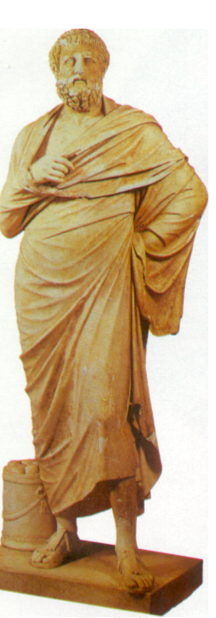
Sophocles, Cont.
When he was twenty eight, he caused a sensation by winning first prize for tragedy at the festival of Dionysus, defeating Aeschylus, the leading playwright of the day.
Over the next sixty-two years, Sophocles went on to win twenty-four first prizes and seven second prizes in thirty-one competitions--the best record of any Greek playwright.
An actor, Sophocles performed in many of his own plays.
He had a weak voice—gave up his acting career for other things.
He was also a priest and general

Slide 34
Sophocles, Cont.
Wrote more than one hundred and twenty tragedies, of which only seven survive today
His plays always contain a moral lesson--usually a caution against pride and religious indifference.
Also a great technical innovator: He added a third actor to Aeschylus‘ original two, introduced painted sets, and expanded the size of the chorus to fifteen.

Slide 35
Sophocles, Cont.
Sophocles wrote the three tragedies (trilogy) about King Oedipus of Thebes and his family over a forty-year period
began with the third part of the story, Antigone, first performed in 442 B.C
Twelve years later, Sophocles backtracked and wrote the first part of the story, Oedipus the King
In the last year of his life, Sophocles wrote the middle segment, Oedipus at Colonus.

Slide 36
The Original Dysfunctional Family
Laius
Jocasta
Creon
Eurydice
Oedipus
Jocasta
Eteocles
Polyneices
Ismene
Antigone
Haemon

Slide 37
The Original Dysfunctional Family
Laius
Jocasta
Creon
Eurydice
Oedipus
Jocasta
Eteocles
Polyneices
Ismene
Antigone
Haemon

