Slide 1
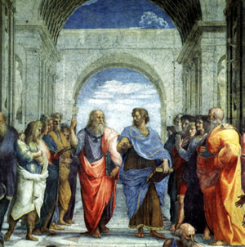
Plato and Aristotle
“Rule of Law” and “Tyranny”
Mr. Chan Saeteurn

Slide 2
Introduction
“Good people do not need laws to tell them to act responsibly, while bad people find a way around the laws”
  Plato
According to Plato's view do you consider yourself a good person or a bad person?
  Why

Slide 3
Outline
Plato
  Background
  Governments
  The Republic
Aristotle
  Background
  Ideas
  Politics
  Rule
“Rule of Law”
“Tyranny”
Terms to look for:
  Plato, Democracy, Autocracy, Monarchy, Philosopher kings, virtuous, Constitutional rule, Aristocracy, middle-class, Polis

Slide 4
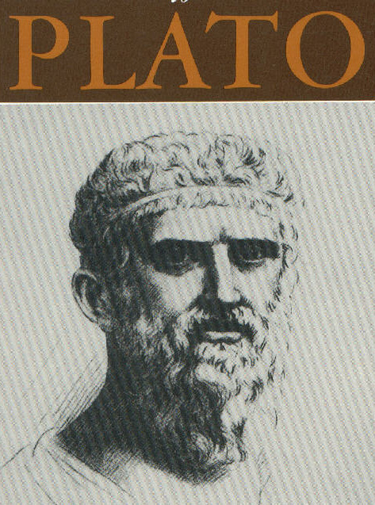

Slide 5
Plato Background
Born to wealthy family Athens Greece in 428 BCE
Age 23 witness defeat of Athens by the Spartans
  Concluded that War= Money
Befriends Socrates
  Searches for meaning of life
  Plato planned to get into Politics
  Socrates was tried and killed
    Plato no longer interested to be in a life of politics

Slide 6
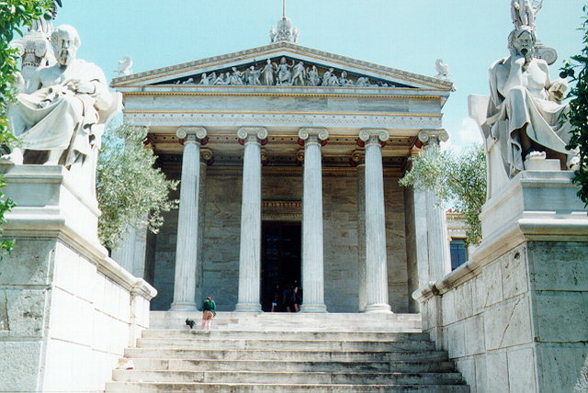
Plato Background Continue
  Plato focuses on how societies can be structured to bring out best of someone
    Promoted study of math, philosophy and government
    Founded Academy of Athens 387 BCE
      Aristotle becomes a student
  Dies 347 BCE

Slide 7
Plato on types of government
Democracy
  Tragically “inadequate” as a form of government
    Calls it “mob rule”
    Ignorant and uneducated government rather than the wise and virtue
Autocracy: Government ruled by a single person with unlimited powers
  Rulers rule for their own self interest and greed rather than the good of the people
  Ambition, fear and greed becomes stronger than reason and humanity
  Results= Tyranny (unjust and cruel government)

Slide 8
Questions
What was happening to Athens during Plato’s Childhood?
What institution did Plato found?
What was dangers of democracy and autocracy?

Slide 9
Plato: The Republic
Plato Rejects Democracy and Autocracy
Main Idea:
  Government can be constructed in a way to get the best of it’s citizens
    People have different strengths and weakness
Ideal Society
  One where everyone knows their role
  Talent determines role in the society
    Not wealth, birthright or gender
    Different Roles
      Strong= Soldiers
      Skilled hands= artisans and laborers
      Wisdom and Virtue= Leaders
    Believes the roles encourages citizens to lead good and just lives
  Believes Education is essential to good government

Slide 10
Plato: The Republic continue
Children= property of the government
  Loyalty to state not parents
  Power never hereditary
  Children will be educated based of their own merit and skills
Division of labor
  Populace (People)
  Administrators (Warriors)
  Rulers

Slide 11
Plato: The Republic continue
Philosopher kings
  The smartest-lover of knowledge, wisdom, and virtue should rule
    Chosen based of their intelligence
    Rulers not allowed to pursue personal ambitions
  Role was to make laws
    Administrators enforces laws
  Lives communally
    Receive no pay
    Not allowed to own property
    Prevents them from making decisions based on their own greed
      Prevents Tyranny

Slide 12
Plato: The Republic questions
What are different roles in Plato’s Society?
How are the different roles determined?
Role of the Philosopher kings?

Slide 13
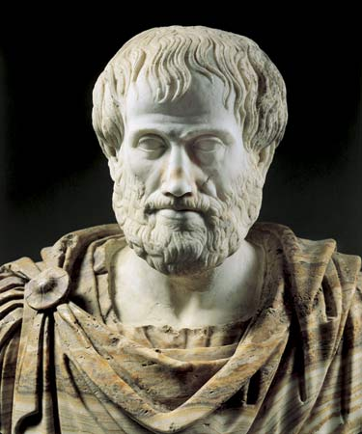
Aristotle

Slide 14
Aristotle Background
Born in Stagira, in a small township in northern Greece in 384 BCE
Studied under Plato at Academy in Athens for 20 years
After Plato’s death Aristotle travelled across Greece and Asia Minor (today Turkey) studying.
Works on ride range of subjects:
  Logic, physics, astronomy, biology, ethics, politics, rhetoric(public speaking) and literary criticism
Became tutor of Alexander the Great when he was young
Died 323 BCE

Slide 15
Aristotle ideas
Language and speech is important since reason comes from use of language
  Reason distinguishes us from Animals
People are not born virtuous (good, moral).
  They must be taught to be good
  Through reason children separate right and wrong
Overtime Humankind has developed higher and higher forms of developments
  Polis (Political communities and societies)

Slide 16
Aristotle Ideas continue
People using reason came together to make societies understand that common good is more important that individual good.
  Without societies, law and order people become selfish and evil
  When unified in Polis can be best creatures
Only through society and government can they realize full potential

Slide 17

Aristotle Questions
What makes humans different from animals?
According to Aristotle are people naturally good?

Slide 18
Aristotle: Politics
3 positive forms of government
  Monarchy (king or queen)
  Aristocracy (noble or wealthy)
  Constitutional rule (people)
Monarchy and Aristocracy are good as long as rulers are virtuous
  If not they can be dangerous
Democracy is less dangerous
  Total equality = harm to society
    People are not equal

Slide 19
Aristotle: Ideal rule
Ideal society
  Everyone is educated to be morally virtually.
  All citizens participate in political society
Middle Class should rule
  Educated members
  Are more stable and rational
    Rich = too arrogant
    Poor= too vengeful
  Impossible to achieve

Slide 20
Aristotle: Rule continue
In world when Aristotle lived kings rule
  Kings should take advise from philosophers
    Kings should not be philosophers
    Allows philosophers be independent in spirit
      If they cannot become wealthy from a position of direct power they would be more honest.

Slide 21
Aristotle: Questions
What are the 3 positive forms of government?
When does Monarchy or Aristocracy become dangerous?
Who is in best position to rule?

Slide 22
Rule of Law
Plato
  Perfect govern society ruled by wisest not the most wealthy or most powerful
  “until philosophers become king… cities won’t rest from their evils”
Aristotle
  Must have big middle class for stable government
    Rich and poor are extremes that would lead to chaos; strong middle class keeps majority happy
  Philosopher kings make laws and administrators enforce them

Slide 23
Tyranny
Plato
  Democracy= inadequate.
    Mob rule
  Autocracy is also dangerous
  Must have balance between power and wisdom
    Use Philosopher kings
      Get no pay or property so they won’t be greedy
Aristotle
  Monarchy and aristocracy are okay, if rulers are virtuous but can be dangerous
  Democracy is least dangerous but total equality isn't realistic and can harm society
  Must have strong middle class.
    If people have moderate and sufficient property, no one will rebel

Slide 24
Outline
Plato
  Background
  Governments
  The Republic
Aristotle
  Background
  Ideas
  Politics
  Rule
“Rule of Law”
“Tyranny”
Terms to look for:
  Plato, Democracy, Autocracy, Monarchy, Philosopher kings, Virtuous, Constitutional Rule, Aristocracy, Middle-class, Polis

Slide 25

STOP

